Slide 1
Charting The Way
Wrap-Up
Not in the Same Boat: Different Tacks for Moving Forward

Slide 2
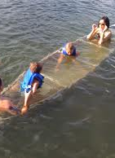
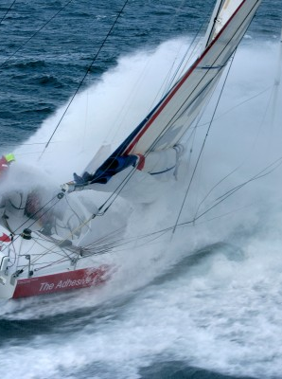
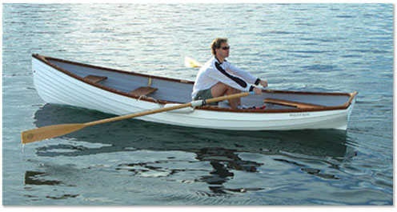
Don’t Give up the Ship
Karen Woodall
Full Steam Ahead
Kate Breslin
STATE BREAKOUT REPORT OUT
Stuck in the Middle
Rich Huddleston

Slide 4
Unprecedented Progress in Covering Children
Lowest uninsured rate since census started collecting data in 1987
Source: U.S. Census Bureau, Current Population Survey, Annual Social and Economic Supplements.

Slide 5
Progress Since CHIPRA

Slide 6
The Potential of the ACA on the Rate of Uninsured Children
5.3%
Source: U.S. Census Bureau, Current Population Survey, Annual Social and Economic Supplements.

Slide 7
Charting the Way Forward
Taking Advantage of the Opportunity to Cover More People
Ensuring that the Exchange serves children and families well
Messaging effectively
Winning from the human perspective

Slide 8
May the wind be with you…
The great thing in this world is not so much where we stand, as in what direction we are moving; we must sail sometimes with the wind and sometimes against it ... but we must sail, and not drift, nor lie at anchor.
Oliver Wendall Holmes

