Slide 1
Wellness Wonder Team
Ashley Boyd
Director of Member Engagement
Senior Campaign Director
MomsRising.org
Mamás Superándose

Slide 2
MomsRising.org
Over 1 million subscribed U.S. members
Over 1,000 bloggers
150+ Partner Organizations
Blog and social media reach to ~ 3.5 million readers

Slide 3
What does it mean to be on the Wellness Wonder Team?
Members will be among the first to hear about new, affordable healthcare options and opportunities.
Members are asked to share this information with at least 10 people.
When members sign up, they receive a “Changing More than Diapers” magnet.

Slide 4
First Outreach

Slide 5
Stories Across the Nation
“I am very concerned about people trying to repeal healthcare reform. My 8 month old son was diagnosed with Cystic Fibrosis when…”
READ FULL STORY
Deirdre
“When I gave birth to my daughter three years ago, not only was I fired from my position but my health insurance was terminated the day she was born...
READ FULL STORY
Rachel
“As a self-employed professional I’ve always had to secure my own health insurance. In the past, whenever I’ve gotten a plan, there was always…”
READ FULL STORY
Dawn

Slide 6
The Wellness Wonder Team in the News

Slide 7
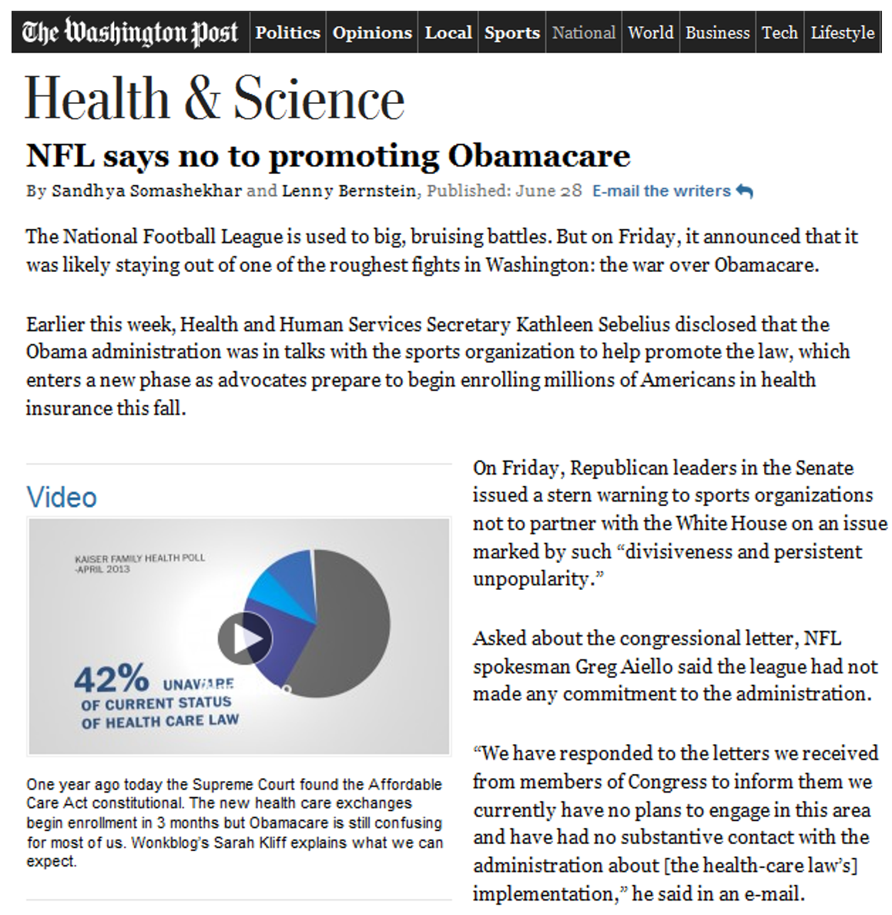

Slide 8
The Wellness Wonder Team
Asks the NFL to Join them!

Slide 9
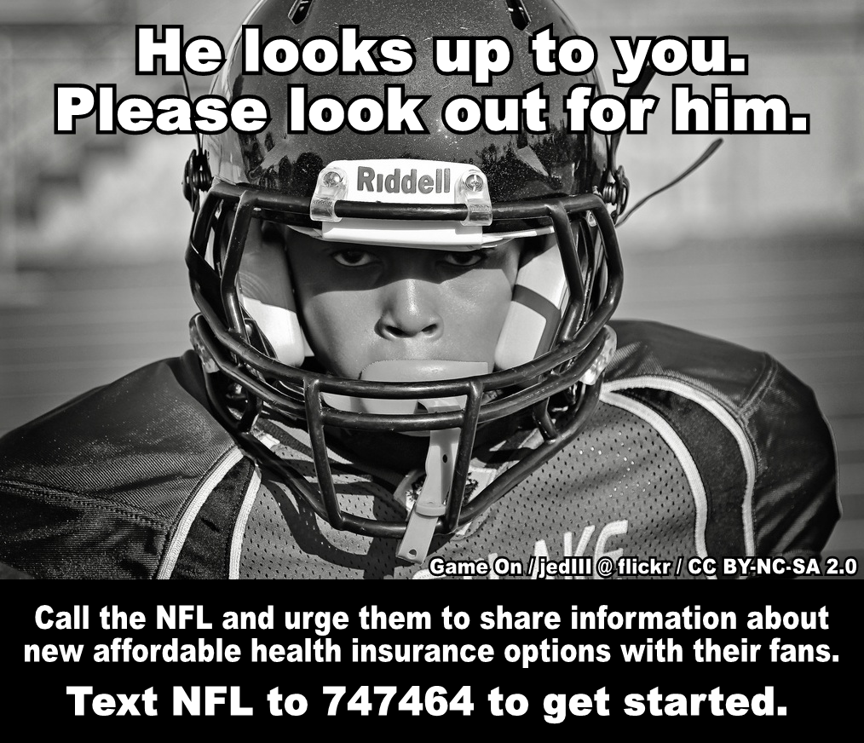
The Wellness Wonder Team
Next Steps
Education
Social Media
MomsRising Near You

Slide 10
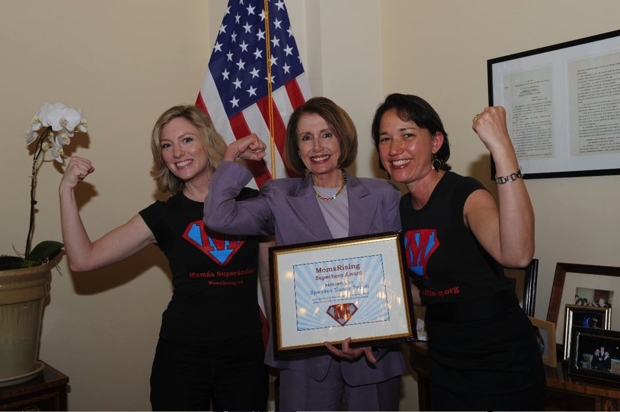
Moms Are Powerful!

Slide 11
Thank You!
Ashley@MomsRising.org

