Slide 1
Opportunity Knocks: Opening the Door for Coverage
2013 Annual Conference
July 30 – August 1, 2013

Slide 2
Opportunity Knocks: A look at 2013
Joan Alker
Executive Director
Annual Conference
July 30, 2013

Slide 3
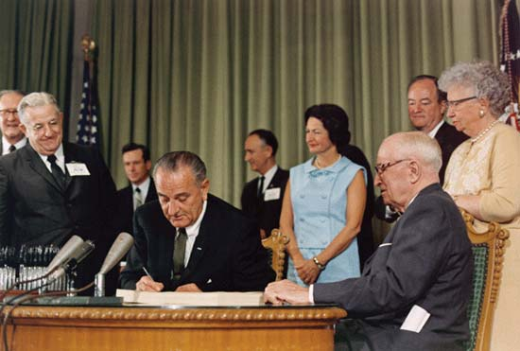
Happy 48th Birthday Medicaid and Medicare!

Slide 4
Children’s Uninsurance Rate Declined While Their Poverty Rate Increased

Slide 5
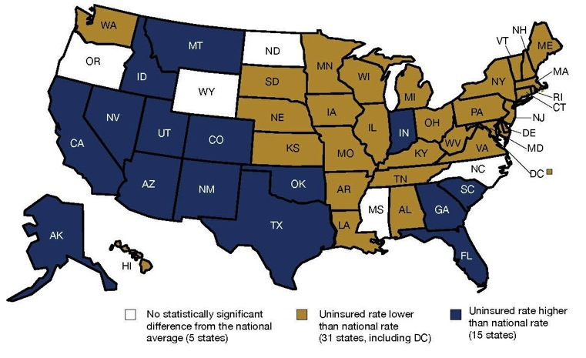
31 States Had Lower Uninsurance Rates for Children than the National Average

Slide 6
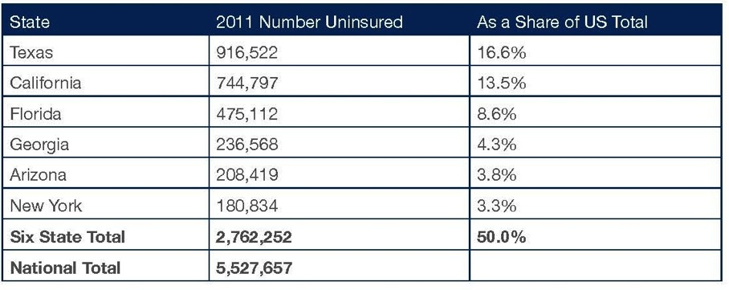
States with the Largest Number of Uninsured Children

Slide 7
Young Adults in the ACA
Number of people without health insurance fell last year for the first time since 2007
Biggest drop in the uninsured was among young adults, falling from 29.8% in 2010 to 27.7% in 2011
Census Bureau said about 40% of the decline in the uninsured rate was among young adults

Slide 8
Opportunity Knocks
70% of uninsured children are eligible but unenrolled for Medicaid/CHIP
Culture of coverage effects of 2014 will reduce this number - - but by how much???
Medicaid expansion for parents critical
Simplicity of paths to coverage also essential especially in states with a federal marketplace
Some children will have new paths to coverage through subsidies

Slide 9
What’s happening at ccf

Slide 10
New Faces at CCF

Slide 11
Forthcoming Publications from CCF
Project with NASHP on separate state CHIP program benefits; also compiling EHBs from every state
Annual ACS report for November release – with lots of lead time and more capacity to respond to your requests for state specific data
Project with Urban on assessing how kids are faring under health reform

Slide 12
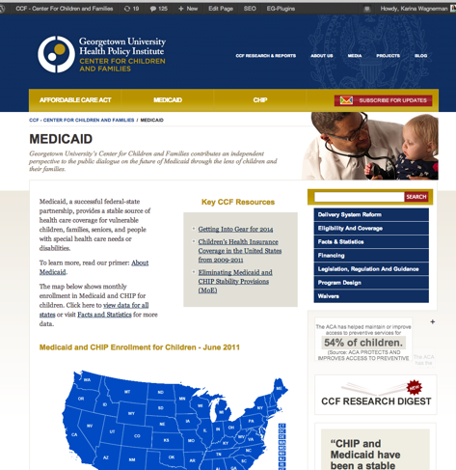
CCF Research Digest – on any page

Slide 13
Our blog continues to grow in readership – we just reached a new record of one thousand views in one day
We LOVE guest bloggers

Slide 14
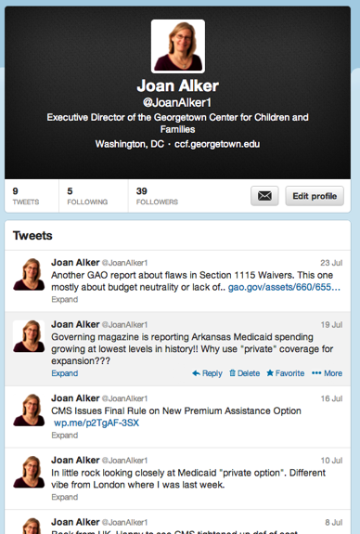
Twitter

Slide 15
Harry Styles has 14.5 Million Followers

Slide 16
What’s Going On in DC?

Slide 17
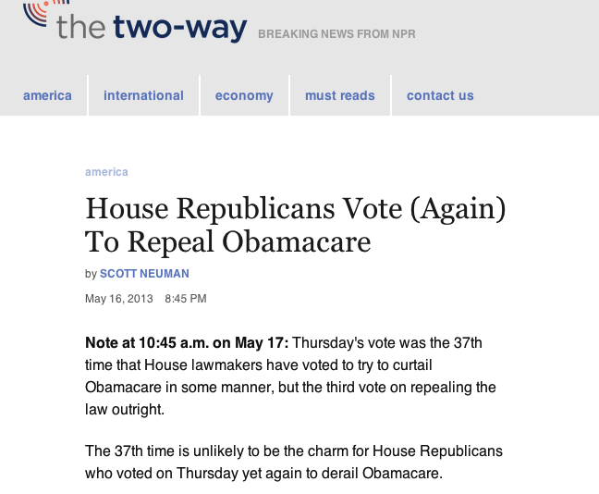
Notes:
Was it 33 last year? Yes it was

Slide 18
Lots of new regulations and guidance
Notes:
Picture – also for notes section that CCF has done 15 sets of comments or letters on proposed guidance and regs in the last 6 months cartoon

Slide 19
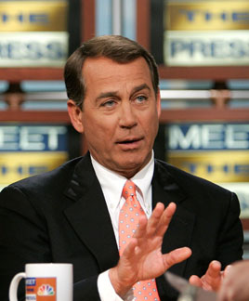
Will there be a budget agreement this fall?

Slide 20
Or will Taylor Swift have the last word?
Notes:
Insert video we are never ever getting back together clip

Slide 21
What is going on around the country?

Slide 22
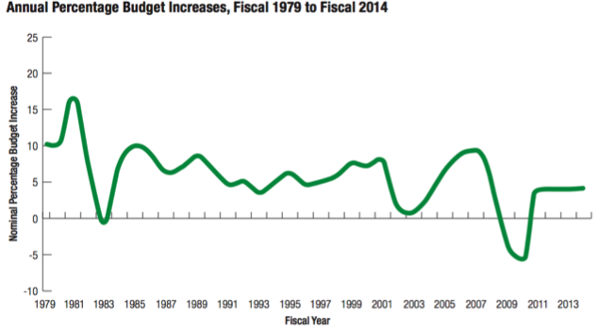
State budgets are improving slowly
General fund spending estimated to increase by 4% in FY 2013 compared to FY 2012, with 42 states estimating greater general fund spending in FY 2013 and 8 states estimating lower.

Slide 23
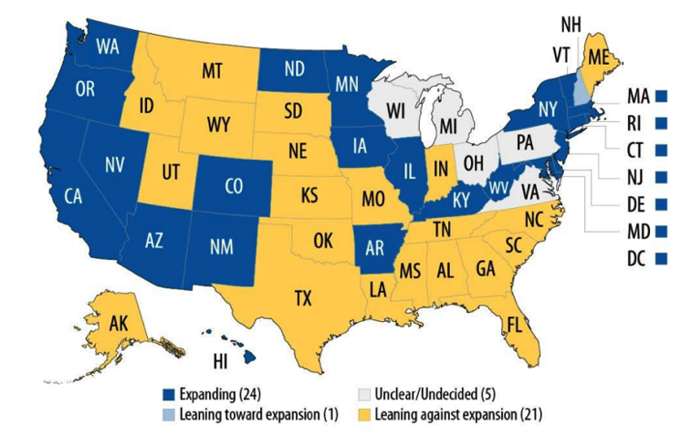
State of Medicaid Expansion

Slide 24
The Cost of NOT Expanding Medicaid
About 2/3 of those originally expected to be covered by the Medicaid expansion are in states not moving forward or still in decision
Texas, Florida and Georgia account for half of the uninsured in states not moving forward
States not moving forward or still in decision will forgo a total of almost $500 billion between 2013-2022

Slide 25
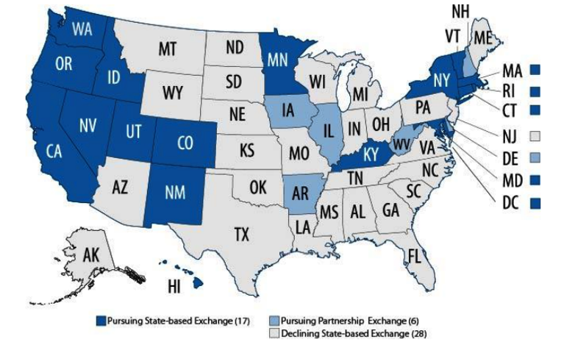
Establishment of State Exchanges

Slide 26
Streamlining enrollment
Work in progress!
States with federally facilitated marketplaces will likely face special challenges aligning with Medicaid and CHIP
Consumer assistance will be key

Slide 27
Conclusion
All of these federal/state decisions will impact how much progress we make on reducing the number of uninsured children
There will be bumps in the road but we must take the long view
Conference is an opportunity to learn and draw strength from our work together to prepare for an unprecedented year ahead

