Slide 1
Health Coverage for Florida’s Children
Joan Alker
Executive Director
Center for Children and Families
Georgetown University
December 3, 2014

Slide 2
How is Florida doing in Covering Kids?

Slide 3
Source: Alker, “Children’s Health Coverage in Florida: Fewer Uninsured But Challenges Lie Ahead”, Florida Philanthropic Network, November 2014.

Slide 4
8.5% of Uninsured Children Live In Florida
 | Percent of Uninsured Children | 2013 State Ranking in Percent of Uninsured Children | Number of Uninsured Children | 2013 State Ranking in Number of Uninsured Children
Florida | 11.1 | 47 | 445,035 | 49
National | 7.1 | - | 5,234,332 | -
Source: “Children’s Coverage at A Crossroads: Progress Slows”, Georgetown Center for Children and Families, November 2014.

Slide 5
Florida Ranks 47th for Uninsured Kids Rate
Florida | 11.1%
Alaska | 11.6%
Arizona | 11.9%
Texas | 12.6%
Nevada | 14.9%
Source: ibid.

Slide 6
Florida Has Been Improving Slowly
 | 2011-2013 Percent Point Change | Rank 2011-2013 Percent Point Change
United States | -0.4 | -
*Florida | -0.8 | 12
*Florida is one of twelve states that experienced a statistically significant decrease in percentage point change
Source: ibid.

Slide 7
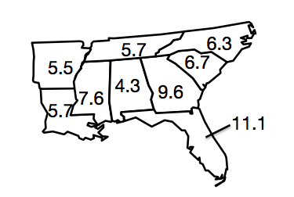
Florida has the highest uninsured rate for kids in the South
5.7
6.3
5.5
6.7
4.3
9.6
7.6
5.7
11.1
Source: “Children’s Health Coverage in Florida: Fewer Uninsured But Challenges Lie Ahead”, Florida Philanthropic Network, November 2014.

Slide 8
Most Uninsured Children are Already Eligible for Medicaid or CHIP
Source: “Medicaid/CHIP Participation Rates Among Children: An Update,” Urban Institute (September 2013).

Slide 9
Florida vs. Neighboring States: Rate of Children’s Participation in Medicaid in 2012
Florida | 85.5%
Alabama | 92.6%
Georgia | 85.8%
Louisiana | 92.5%
South Carolina | 87.5%
Texas | 84.3%
Source: ibid.

Slide 10
Who Are Florida’s Uninsured Children?

Slide 11
FL Counties with Largest # of Uninsured Children
County | Number of Uninsured Children
Miami-Dade County | 64,806
Broward County | 48,217
Orange County | 35,429
Palm Beach County | 33,233
Hillsborough County | 26,639
Duval County | 17,138
Polk County | 17,061
Lee County | 16,560
Pinellas County | 14,628
Osceola County | 12,447
Source: “Children’s Health Coverage in Florida: Fewer Uninsured But Challenges Lie Ahead”, Florida Philanthropic Network, November 2014.

Slide 12
Florida’s Public Coverage in Urban and Rural Areas
Inside Metro Areas (Urban) | Outside Metro Areas (Rural)
Percent of Children with Public Insurance | Percent of Children with Public Insurance | Rural/Urban Difference (Rural Rate-Urban Rate)
34.9 | 46.9 | 12
Source: “Rural Children Increasingly Rely on Medicaid and State Child Health Insurance Programs for Health Insurance”, First Focus, September 2014.

Slide 13
Children’s Coverage Source by Income in Florida, 2013
Percent of federal poverty line (FPL) | Medicaid | ESI | Uninsured
Under 100% FPL | 75.6% | 9.2% | 12.2%
100-137% FPL | 64.1% | 17.2% | 15.3%
138-199% FPL | 46.9% | 32.5% | 16.3%
200-299% FPL | 29.8% | 48.5% | 12.3%
300% FPL and above | 10.0% | 71.5% | 6.1%
Source: “Children’s Health Coverage in Florida: Fewer Uninsured But Challenges Lie Ahead”, Florida Philanthropic Network, November 2014.

Slide 14
Age of Uninsured Child, Florida 2013
Children under age 6
Children age 6-17
7.9% are uninsured
12.6% are uninsured
Source: Ibid

Slide 15
Florida’s Uninsured Children by Race
*Note: Hispanic children can be of any race. While Hispanic children account for 29% of the child population, they are disproportionately uninsured at 37.7%
Source: Ibid

Slide 16
States with Highest Rate of Uninsured Hispanic Children
Source: Hispanic Children’s Coverage: Steady Progress, But Disparities Remain
Schwartz, et al. Georgetown Center for Children and Families/National Council of la Raza

Slide 17
2013 Number and Rate of Uninsured
Hispanic Children
State | Number | Rate
Texas | 585,498 | 17.0%
California | 454,740 | 9.6%
Florida | 167,917 | 14.4%
Arizona | 105,377 | 15.1%
Georgia | 64,489 | 19.2%
Five State Total | 1,378,021
National Total | 2,035,787
Source: Ibid

Slide 18
How has Implementation of the ACA Affected Children in Florida?

Slide 19
How are We Doing on Insuring Children and Adults?
*Data source: Health Reform Monitoring Survey quarter I 2013 through quarter 2 2014, Urban Institute and Georgetown Center for Children and Families.
Source: American Community Survey (ACS) through 2013.

Slide 20
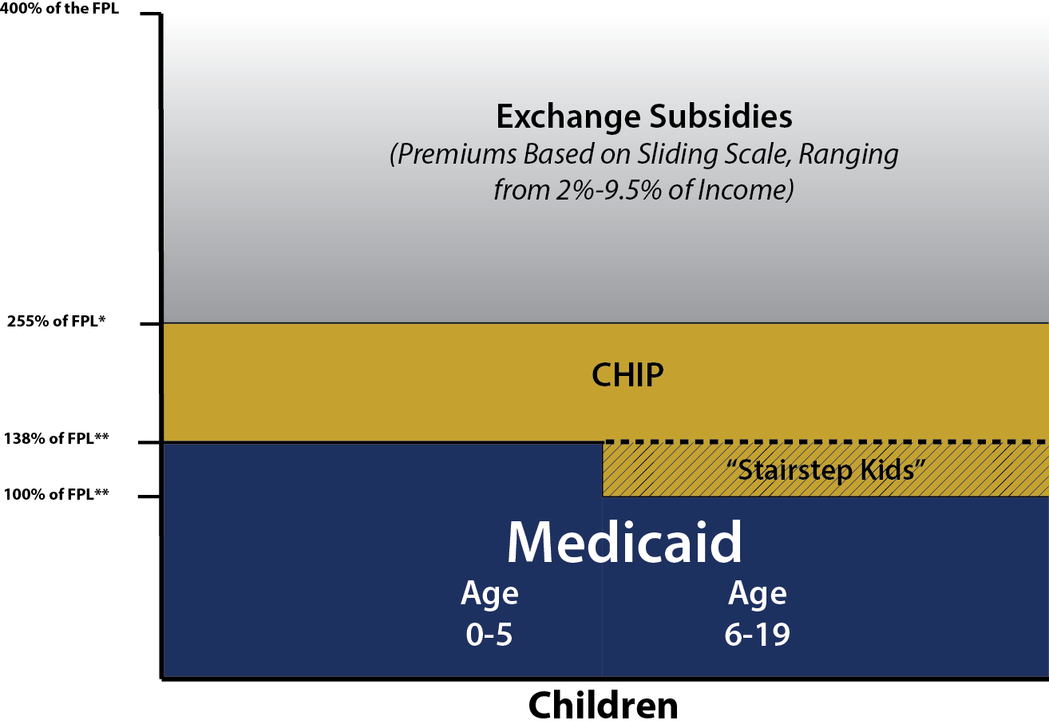
Children’s Coverage in the United States, 2014
SOURCE: Based on the results of a national survey conducted by the Kaiser Commission on Medicaid and the Uninsured and the Georgetown University Center for Children and Families, Updated by KCMU.

Slide 21
Moving “Stairstep” Kids to Medicaid
Intended to align family eligibility
28% of CHIP kids nationally;
Florida Estimating Conference projects 51,059 kids will transfer
States continue to receive the CHIP enhanced FMAP
21 States affected
Notes:
Check our report for Kaiser on this to see how many states affected and add #

Slide 22
States that Charged Premiums at 101% FPL, 2013
Arizona $10/Month
Delaware $10/Month
Florida $15/Month
Georgia $10/Month
Nevada $25 Quarterly
Utah $30 Quarterly
Alabama $52 Annually
Source: Kaiser/Georgetown Annual Survey of State Eligibility and Enrollment Practices

Slide 23
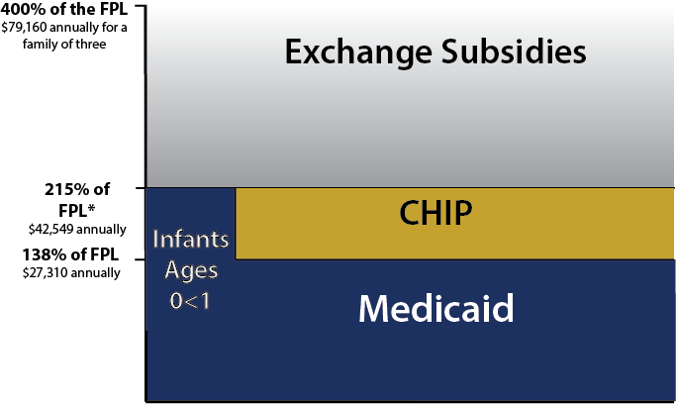
Sources of Coverage for Florida’s Children
*Median income threshold—based on the results of a national survey conducted by Kaiser Commission on Medicaid and the Uninsured and Georgetown University Center for Children and Families
Medicaid income eligibility for infants ages 0 <1 is up to 211% FPL
Sources: Health Insurance Marketplace: Summary Enrollment Report for the Initial Annual Open Enrollment Period, ASPE, May 2014.

Slide 24
Growth in Child Enrollment in Medicaid/CHIP, March – August 2014
Source: Recent Trends in Medicaid and CHIP Enrollment: Kaiser Commission on Medicaid, October, 2014.

Slide 25
What Issues Looking Forward Will Affect the Number of Uninsured Children?

Slide 26
Florida Policy choices

Slide 27
Medicaid expansion to cover parents
Florida has not accepted federal funding to cover parents and other low income adults
Parent coverage helps children:
Financial security of the family enhanced
Parents are healthier; maternal depression declines
Children’s coverage rates improve!

Slide 28
Cover lawfully residing children
Florida has not extended KidCare coverage to lawfully residing immigrant children; although they can now get ACA tax credits
Would extend eligibility to fewer than 20,000 kids but would extend welcome mat to mixed status families and help reduce the high rate of uninsured Hispanic children

Slide 29
Lower Premiums
Eighteen states do not charge premiums for children
The majority of states (30) charge no premiums to families below 200% FPL, which is Florida’s upper income limit for eligibility
Florida is one of just eight states that charge premiums to the lowest income children who are eligible—families at 138% FPL

Slide 30
Eliminate waiting periods for Healthy Kids
Florida has a two month waiting period for Healthy Kids with lots of exceptions
These rules no longer make sense post ACA when families will be penalized for not having coverage and adds administrative complexity
Twenty states have dropped their waiting period in last year

Slide 31
the future of CHIP: What will congress do?

Slide 32
CHIP 101
Established in 1997; block grant as opposed to entitlement like Medicaid
Has been well funded esp. of late
Higher match rate than Medicaid
States can choose to do Medicaid expansion v. separate state program or combination which Florida has (i.e. KidCare/Healthy Kids)
Funding expires September 30, 2015 if Congress takes no action

Slide 33
Sources of Coverage for Florida’s Children
*Median income threshold—based on the results of a national survey conducted by Kaiser Commission on Medicaid and the Uninsured and Georgetown University Center for Children and Families
Medicaid income eligibility for infants ages 0 <1 is up to 211% FPL
Sources: Health Insurance Marketplace: Summary Enrollment Report for the Initial Annual Open Enrollment Period, ASPE, May 2014.

Slide 34
How do CHIP Benefits Compare to Exchange?
CHIP benefits and cost-sharing protections are better for kids than QHPs
In Florida CHIP had an actuarial value of 98% for family at 160% FPL v. 86-88% in QHP
Average annual cost-sharing for FL Healthy Kids $62 v. $411-480 in QHPs.
“Comparison of Benefits and Cost Sharing in Children’s Health Insurance Programs to Qualified Health Plans”, Wakely Consulting Group and First Focus, July 2014.

Slide 35
What Happens to CHIP Kids if Funding Runs Out in 2015?
CHIP-funded children will fall under one of the following scenarios:
Maintain coverage on Medicaid – state receives lower match/less federal funding
Fall into “family glitch” and become uninsured
Could affect 2 million kids
Move to marketplace coverage with tax credits for families
Opt in to other private and likely unaffordable coverage options
Get lost in the shuffle and become uninsured

Slide 36
What Happens to CHIP Kids in Florida if Funding Runs Out in 2015?
Georgetown preliminary analysis with CBPP finds that nearly four million children would lose CHIP coverage in U.S. and many of these would likely become uninsured – approximately 400,000 of these kids live in Florida.
Source: Estimates derived from figures in preliminary unpublished draft memo “CHIP Financing Considerations and State-level Funding and Coverage Loss Estimates,” Georgetown Center for Children and Families and Center on Budget and Policy Priorities, October 2014.

Slide 37
What’s at Stake for Florida’s Budget?
Preliminary Estimates show a loss of up
to $495-$560 million in 2016
FL FY 2015 FMAP for Medicaid | FL FY 2015 Enhanced FMAP for CHIP | FL FY 2016 Enhanced FMAP* for CHIP
59.27% | 71.8% | 94.8%
*This estimate is calculated by adding the 23 percentage point bump to the 2015 enhanced FMAP for Florida. Actual percentage in 2016 may vary slightly given that the FMAP is adjusted annually.
Source: ibid.

Slide 38
For More Information
Joan Alker:
jca25@georgetown.edu
Twitter @JoanAlker1
CCF website: ccf.georgetown.edu
Twitter @GeorgetownCCF
Say Ahhh! Our child health policy blog: ccf.georgetown.edu/blog/

