Slide 1
Medicaid/CHIP Participation among Children and Parents
Victoria Lynch
Genevieve M. Kenney
The Urban Institute
December 17, 2012

Slide 2
Reference: Kenney, G., V. Lynch, M. Huntress, J. Haley, and N. Anderson. 2012. Medicaid/CHIP Participation Among Children and Parents. Washington, DC: Urban Institute and Robert Wood Johnson Foundation.
<http://www.urban.org/UploadedPDF/412719-Medicaid-CHIP-Participation-Among-Children-and-Parents.pdf>

Slide 3
Road Map
Data and Methods
Participation in Medicaid/CHIP among Children
Eligible but Uninsured Children
Participation in Medicaid among Parents
Eligible but Uninsured Parents

Slide 4
Data
American Community Survey
Annual survey fielded continuously over a twelve months period.
Sample is drawn from each county in the nation.
The sample frame includes household with and without telephones.
Information on approximately 700,000 sample children and 600,000 parents available for analysis each year.
Mixed mode survey based on a combination of a mail survey and follow up telephone and in person interviews.
Response rate of 98% reported by Census.
Allows more precise state and local estimates than previously possible.

Slide 5
What Information is Included on the ACS?
Based on the long form from the decennial census:
Income, marital status, education, occupation, functional limitation, etc.
Income and household structure information is more limited than on the CPS but appears quite robust.
In 2008, for the first time, households were asked about insurance coverage status.

Slide 6
ACS Mail Questionnaire Health Insurance Item
Is this person CURRENTLY covered by any of the following health insurance or health coverage plans? Mark “Yes” or “No” for EACH type of coverage in items a-h
Insurance through a current or former employer or union (of this person or another family member)
Insurance purchased directly from an insurance company (of this person or another family member)
Medicare, for people age 65 and over, or people with certain disabilities
Medicaid, Medical Assistance, or any kind of government-assistance plan for those with low incomes or a disability
TRICARE or other military health care
VA (including those who have ever enrolled for or used VA health care)
Indian Health Service
Any other type of health insurance or health coverage plan- specify

Slide 7
Methods
Concern that the ACS may understate Medicaid and CHIP coverage.
Edit rules were applied that build on those developed by the Census Bureau to account for this. Result was an increase in estimated numbers of children and adults with Medicaid/CHIP and a reduction in the estimated number of uninsured children and an increase for adults—revised ACS estimates are closer to NHIS estimates.
Simulation model uses state-level Medicaid and CHIP eligibility guidelines to determine eligibility of each child and parent based on family-level characteristics, including income.

Slide 8
Methods, cont.
Participation rates are defined as the ratio of eligible children/parents enrolled in Medicaid/CHIP to those children/parents plus uninsured children/parents who are eligible for Medicaid/CHIP.
Modeling eligibility/participation for adults is more difficult than for children due to greater complexity and variety in the pathways through which eligibility might be attained.
All estimates use weights provided by the Census Bureau and standard errors use replicate weights that take into account the complex nature of the sample design.

Slide 9
National Medicaid/CHIP Participation Rate Among Children
Source: 2008, 2009, 2010 American Community Surveys
Notes: Universe is limited to civilian noninstitutionalized children (0-18).
*(**) Denotes estimate is statistically different from prior year estimate at the 0.1(0.05) level.

Slide 10
Changes in Medicaid/CHIP Participation Rates Among Children between 2008 and 2010
Source: Analysis of 2008 and 2010 American Community Surveys (ACS) data from the Integrated Public Use Microdata Series (IPUMS).
Notes: ^ Denotes reference category within group. **(*) indicates estimate is statistically different from the reference category at the 0.05 (0.1) level. ++(+) indicates difference estimate is statistically different from zero at the 0.05 (0.1) level. Income is defined as gross income as a percentage of the Census defined poverty level.

Slide 11
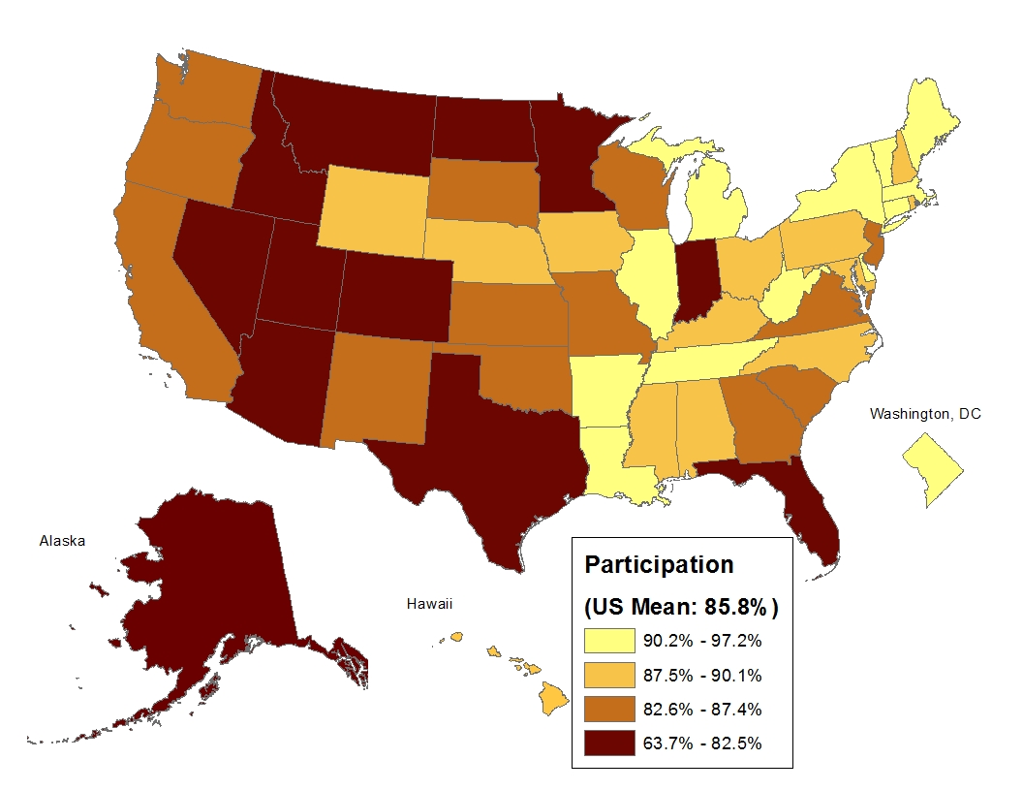
Children’s Participation in Medicaid/CHIP, 2010

Slide 12
Uninsurance Rate Among All Children, 2008, 2009, and 2010
9.2%
8.4%**
8.0%**##
Source Analysis of Urban Institute Health Policy Center’s ACS Medicaid/CHIP Eligibility Simulation Model, based on American Community Survey (ACS) 2008, 2009 , and 2010 data from the Integrated Public Use Microdata Series (IPUMS).
Notes Estimates reflect an adjustment for the underreporting of Medicaid/CHIP and military coverage on the ACS.
*(**) Denotes estimate is statistically different from prior year estimate at the 0.1(0.05) level. #(##) Denotes 2010 estimate is statistically different from 2008 estimate at the 0.1(0.05) level.

Slide 13
Estimated Number of Medicaid/CHIP Eligible but Uninsured Children
4.9 million
4.6 million
4.4 million
Source: 2008, 2009, and 2010 American Community Survey
Notes: Universe limited to civilian noninstitutionalized children (0-18).

Slide 14
Eligibility of Uninsured Children for Medicaid/CHIP Coverage, 2010
Not Eligible for Medicaid/CHIP (1.9 million)
Eligible for Medicaid/CHIP, Less than 133% FPL (2.8 million)
30.4%
44.7%
Eligible for Medicaid/CHIP, Greater than 133% FPL (1.6 million)
24.9%
{6.3 million uninsured in total}
Source Analysis of Urban Institute Health Policy Center's ACS Medicaid/ CHIP Eligibility Simulation Model, based on data from the 2010 American Community Survey (ACS). Notes Estimates reflect an adjustment for the misreporting of coverage.

Slide 15
Number of Eligible but Uninsured Children, Top 10 States

Slide 16
Opportunities to Cover More Children
Eligible but uninsured children are concentrated in several states- almost half reside in just 5 states.
Successful efforts to enroll eligible children in these states can have a large impact on the number of uninsured children nationwide.
1.8 million of the estimated 4.4 million eligible but uninsured children have uninsured parents who are currently eligible or could be under the ACA in 2014.
Policies aiming to insure parents are likely to have an impact on their children’s insurance coverage as well.

Slide 17
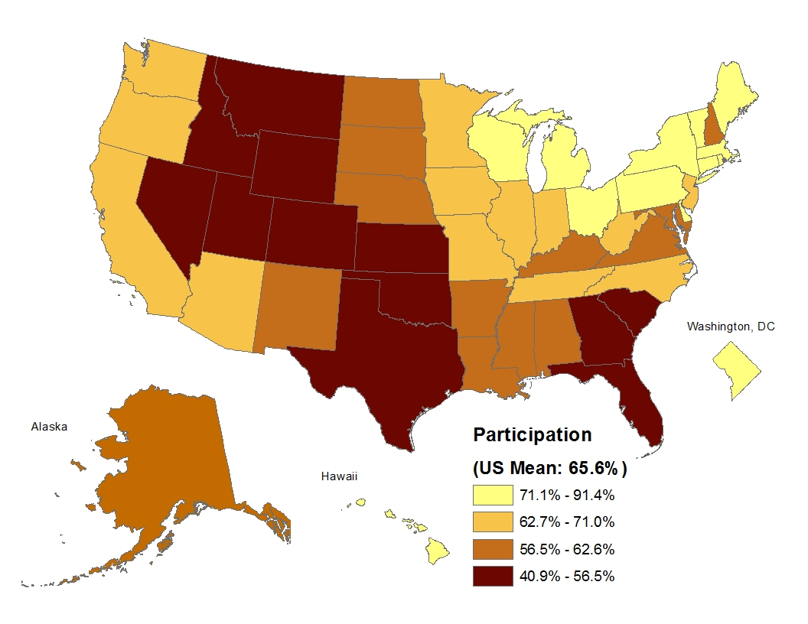
Parents’ Participation in Medicaid/CHIP, 2010
Source: 2010 American Community Survey
Notes: Universe limited to civilian noninstitutionalized parents (19-64)

Slide 18
Participation Among Parents
Participation rates among children are 20 percentage points higher than among parents nationally, with higher participation rates among children in every state.
Participation patterns tend to be similar across states for both parents and children, though there are exceptions.

Slide 19
Eligible But Uninsured Parents
One in 4 eligible parents was uninsured during 2009/2010.
The uninsurance rate was over 40% among eligible parents in 8 states.

Slide 20
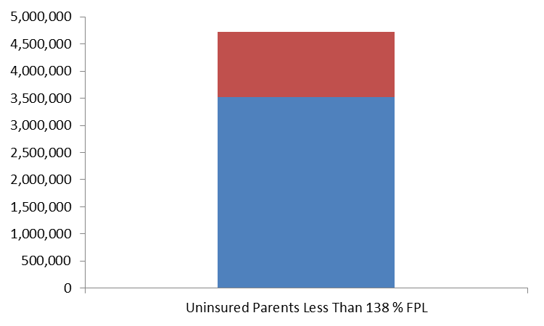
Low-Income Uninsured Parents with an Eligible Child, 2010
25.5%
Has an Eligible but Uninsured Child
Has a Child Enrolled in Medicaid
74.5%
Source: Heberlein M, Huntress M, Kenney G, Alker J, Lynch V, and Mancini T. “Medicaid Coverage for Parents under the Affordable Care Act.” Washington, DC: Georgetown University Center for Children and Families, 2012. Available at http://ccf.georgetown.edu/wp-content/uploads/2012/08/Medicaid-Coverage-for-Parents.pdf

Slide 21
Opportunities to Cover More Parents
Approximately 2.2 million uninsured parents are currently eligible for Medicaid.
Nearly three-quarters of the uninsured parents who could be eligible for Medicaid in 2014 have a child who is enrolled.
Target parents of children in Medicaid/CHIP for enrollment
Children’s participation increased after states implemented new policies under CHIPRA
Adopt the strategies that worked for children for adults

Slide 22
Limitations
Measurement error in coverage and other ACS data.
Incomplete/inaccurate information in the eligibility simulation model.
Small state estimates (such as North Dakota, Vermont, and Wyoming) are less precise because of the relatively smaller sample sizes available for them.

Slide 23
Conclusions
Progress was made to reduce children’s uninsurance between 2008 and 2010:
Successful outreach/enrollment efforts associated with increases in Medicaid/CHIP participation and decreases in the number of eligible but children and the uninsured rate among children.
Participation in Medicaid for parents trails behind children’s rates by large margins:
This may have adverse impacts not only on parents, but also on their children’s and families’ health and wellbeing.
Many low income uninsured parents have children who are enrolled in Medicaid/CHIP. This may serve as an efficient pathway to find and enroll eligible but uninsured parents, especially in 2014 for states that expand Medicaid.

Slide 24
Looking Ahead…
If fully implemented, the ACA is expected to reduce uninsurance among children and parents by 40 and 50 percent, respectively.
The gains projected under the ACA rely heavily on increased enrollment in Medicaid/CHIP coverage and will depend on state-level decisions on the Medicaid expansion under the ACA as well as on state-level enrollment and retention polices.

Slide 25
Works Cited
Heberlein M, Huntress M, Kenney G, Alker J, Lynch V, and Mancini T. “Medicaid Coverage for Parents under the Affordable Care Act.” Washington, DC: Georgetown University Center for Children and Families, 2012.
Kenney, G., M. Buettgens, J. Guyer, and M. Heberlein. 2011. “Improving Coverage For Children Under Health Reform Will Require Maintaining Current Eligibility Standards For Medicaid And CHIP.” Health Affairs 30(12): 2371-2381.
Kenney, G., V. Lynch, J. Haley, M. Huntress, D. Resnick, and C. Coyer. 2011. Gains for Children: Increased Participation in Medicaid and CHIP in 2009. Washington, DC: Urban Institute and Robert Wood Johnson Foundation.
Kenney, G., V. Lynch, M. Huntress, J. Haley, and N. Anderson. 2012. Medicaid/CHIP Participation Among Children and Parents. Washington, DC: Urban Institute and Robert Wood Johnson Foundation
King, J., G. Kenney, and M. Huntress. 2011. “Reaching out in Rural Areas Children’s Medicaid and CHIP Participation.” Presentation at Connecting Kids to Coverage: 2nd National Children’s Health Insurance Summit. Chicago, Il. November 3rd, 2011.
Lynch V., M. Boudreaux, and M. Davern. 2010. Applying and Evaluating Logical Coverage Edits to Health Insurance Coverage in the American Community Survey. Suitland, MD: U.S. Census Bureau, Housing and Household Economic Statistics Division
Lynch V, G. Kenney, J. Haley, and D. Resnick. 2011. Improving the Validity of the Medicaid/CHIP Estimates on the American Community Survey: The Role of Logical Coverage Edits.
McMorrow, S., G. Kenney, and C. Coyer. 2011. “Addressing Coverage Challenges for Children Under the Affordable Care Act.” Washington DC. The Urban Institute.

