Slide 1

Children’s Coverage in Arizona: What Does it Mean for the Future of CHIP?
Joan Alker, Georgetown Center for Children and Families
Elisabeth Wright Burak, Georgetown Center for Children and Families
Michael Perry, PerryUndem Research/Communication
Joseph Fu, Arizona’s Children’s Action Alliance
Dr. Tim Jordan, Jordan Developmental Pediatrics

Slide 2

Joan Alker
Georgetown Center for Children and Families

Slide 3
Overview
What changes has Arizona made to CHIP?
About this research
What do parents say about the loss of KidsCare?
View from a pediatrician’s office
What can Arizona’s experience tell us about the future of CHIP?

Slide 4

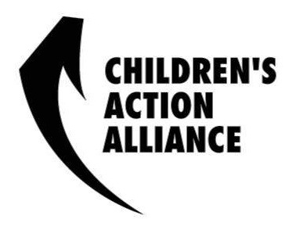
Joe Fu
Children’s Action Alliance

Slide 5

Arizona’s Dismantling of CHIP: History of KidsCare and KidsCare II

Slide 6
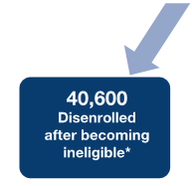

Arizona’s Dismantling of CHIP: History of KidsCare and KidsCare II

Slide 7

Arizona’s Dismantling of CHIP: History of KidsCare and KidsCare II

Slide 8
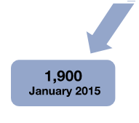
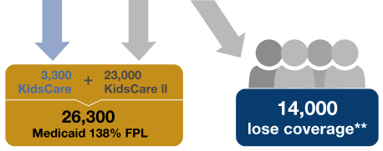
Arizona’s Dismantling of CHIP: History of KidsCare and KidsCare II

Slide 10

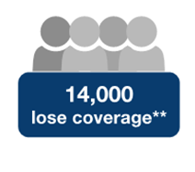

Arizona’s Dismantling of CHIP: History of KidsCare and KidsCare II
Much higher costs on Marketplace (Georgetown CCF and CAA May 2014 study)
?
Family Glitch
AND all AZ families between 138%-200%
Employer
Uninsured

Slide 11

Elisabeth Wright Burak
Georgetown Center for Children and Families

Slide 12


Michael Perry

Slide 13
Living Without KidsCare
Insights from Parents of Children Who Lost Their Health Coverage When Arizona Scaled Back Its Children’s Health Insurance Program

Slide 14
The Study
Georgetown University’s Center for Children and Families sponsored two focus groups and three interviews with Arizona parents who had children enrolled in KidsCare.
Fourteen thousand Arizona children lost their health insurance at the end of January 2014 when the state ended its KidsCare program. This study offers a glimpse into what happened to these families.
PerryUndem Research and Communication conducted the focus groups and interviews. Joe Fu, Director of Health Policy at Children's Action Alliance, a children’s advocacy organization in Arizona, helped identify and recruit families who had lost coverage.
The focus groups were held in Phoenix in October 2014. One group was conducted in Spanish with five Spanish-speaking Latino parents; the other group was held with five English-speaking parents of mixed racial and ethnic backgrounds. The three additional interviews were conducted in November. In all, 13 families participated in this study.

Slide 15
Key Findings
1
All parents in this study were highly satisfied with KidsCare.
But some parents were frustrated by the frequent changes to KidsCare even before the program ended – some found it difficult to keep their children enrolled over the years.
Most parents were unprepared for the end of KidsCare in January 2014. They say they did not receive clear information about why the program was ending or where they should look for new coverage.
“[KidsCare] covered everything. I used to take my daughters to their appoint-ments and I never really had a problem. I was really happy.”
Latina, Spanish-Speaking Parent
2
3

Slide 16
Key Findings
4
Some of these families floundered when KidsCare ended. Some children were transferred directly into the AHCCCS program without any gaps in coverage. The rest applied to AHCCCS later, looked to their employer for coverage, and/or applied for marketplace coverage. Four of the children were uninsured for at least some time period after KidsCare ended.
There were disruptions in care for many children when KidsCare ended and some negative effects on children’s health.
“[My employer’s plan] would be another rent for me and I just can’t afford it.”
Mother of Formerly Enrolled Child
5

Slide 17
Key Findings
6
Parents who were able to enroll their children in AHCCCS seem most satisfied.
Parents with children who did not qualify for AHCCCS are under financial stress and their children face more difficulties accessing care.
All want KidsCare to be reinstated. They feel the program was affordable and offered high quality care for their children. They feel there is no safety net for them anymore.
“KidsCare used to be the option before if [my child] did not qualify for AHCCCS. But now what?”
Mother of Formerly Enrolled Child
7
8

Slide 18

Dr. Timothy Jordan
Jordan Developmental Pediatrics
Phoenix, AZ

Slide 19
Elisabeth Wright Burak
Georgetown Center for Children and Families

Slide 20
Children’s coverage fluctuations reflect state policy decisions

Slide 21
What can Arizona’s Experience with Children’s Coverage tell us about the future of CHIP?
CHIP eligibility rollbacks or new restrictions could make more children uninsured
Without ACA maintenance of effort (MOE), states may choose to cut children’s coverage
Children cannot yet rely on marketplace coverage to meet their needs
Without the ACA “stairstep” provision, more children would lose coverage

Slide 22
Without the ACA “stairstep” provision, more children would lose coverage

Slide 23
Conclusion
Arizona’s experience underscores the importance of keeping CHIP and Medicaid strong.
Uncertainty about CHIP’s future threatens our nation’s progress covering children and ensuring they get the care they need to thrive.

Slide 24

Questions?
Please submit questions at this time

Slide 25
For more information
CCF website: ccf.georgetown.edu
Twitter @GeorgetownCCF
Say Ahhh! Our child health policy blog: ccf.georgetown.edu/blog/
Media Inquiries
Cathy Hope: cjh73@georgetown.edu
  (202) 687-1058

