Slide 1
Amy Zimmerman, JD
Program Director, Legal Council for Health Justice
azimmerman@legalcouncil.org
Kaylan Szafranski
Manager, Health Reform Initiative
EverThrive Illinois
kszafranski@everthriveil.org

Slide 2
Developmental Screening as State Priority
On the State Level:
DCFS Illinois Child Welfare Transformation Plan
IDPH Maternal and Child Health Title V Action Plan and IDPH Statewide Developmental Screening Summit
CDPH Healthy Chicago 2.0
ExceleRate Illinois
Recommended metric in the ELC dashboard of Early Childhood System Success

Slide 3
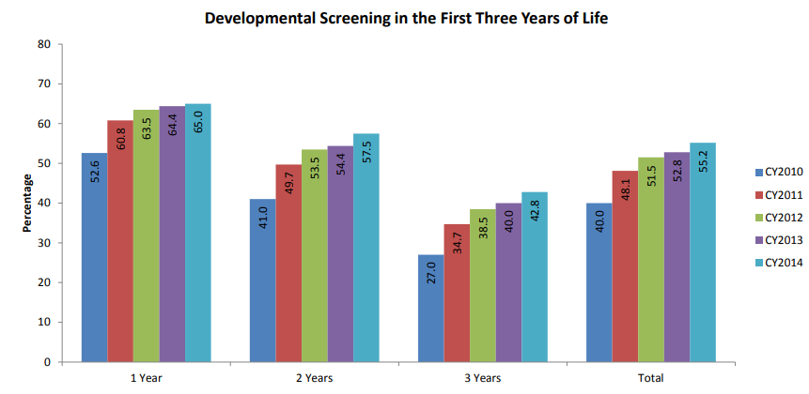
Developmental Screening Population Analysis- 96110 Billing Data
Source: CHIPRA Core Set of Children’s Health Care Quality Measures for Medicaid and CHIP: Illinois’ Performance Calendar Year 2010 through 2014
https://www.illinois.gov/hfs/SiteCollectionDocuments/FINAL2015CCSDbk9-26-16.pdf

Slide 4
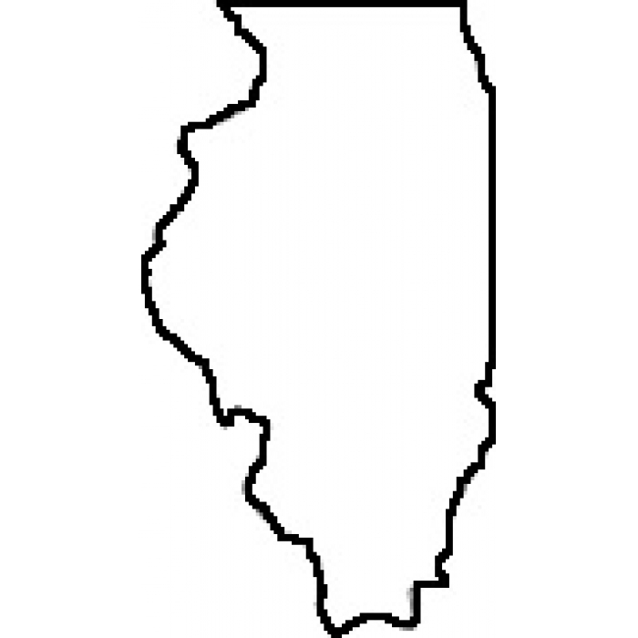
Developmental Screening Population Analysis
National Survey of Children’s Health 2016
Indicator 4.10: Child (age 9-35 months) received a developmental screening using a parent-completed screening tool
39.4%
Indicator 4.11: Children currently receiving special services to meet his or her developmental needs as speech, occupational, or behavioral therapy
7.7%
Illinois ranks
13th
in the nation for developmental screenings
Retrieved [05/23/18] from: www.childhealthdata.org

Slide 5
Early Care and Education Role in Developmental Screening
Almost all early childhood programs are either required to do developmental screenings or ensure that children get developmental screenings.
Head Start/Early Head Start: Developmental Screening required within 45 days of enrollment for 3-5 year olds and annually; infants and toddlers as screening tool indicates. Referrals required.
Preschool for All/Prevention Initiative: Developmental Screening required to determine eligibility for enrollment for 0-5 year olds (at least 3 months of age). Additional developmental screening required within 60 days of enrollment for 3-5 year olds and at least every 6 months for infants and toddlers. Referrals Required.
Home Visiting: All models require developmental screening and referral, intervals vary according to tool.
Child Care: Required to make families aware of existing opportunities for developmental screenings.
Child Welfare (DCFS): Required for all wards 0-5, available to Intact Family service cases (0-3) and children of teen wards (0-3).

Slide 6
ExceleRate & Child Screening
To move from licensing to Bronze
To move from Bronze to Silver
To move from Silver to Gold
Program administrator must complete a Gateways Registry-approved training on screening tools
Program must have policies and procedures ensuring children ages 0-5 are screened at least annually
Program must have policies and procedures to ensure children ages 0-5 are screened no later than 60 days after entry into the program, parents are provided information on results, and children are referred to a CFC or school district for further evaluation.

Slide 7
Referrals and Connections to Services
Early Identification requires more than developmental screenings
After all children screened, what would an ideal system of referral and connection look like?
Early childhood and health provider capacity to discuss results and engage families
Parents with knowledge and support to navigate systems
Coordinated systems for referral, follow-up, and service connections
No Wrong Door – easy system points of entry
Child-Level Data—screening, results, referrals and receipt of service
Increased access to availability of services that meet children and families’ needs

Slide 8
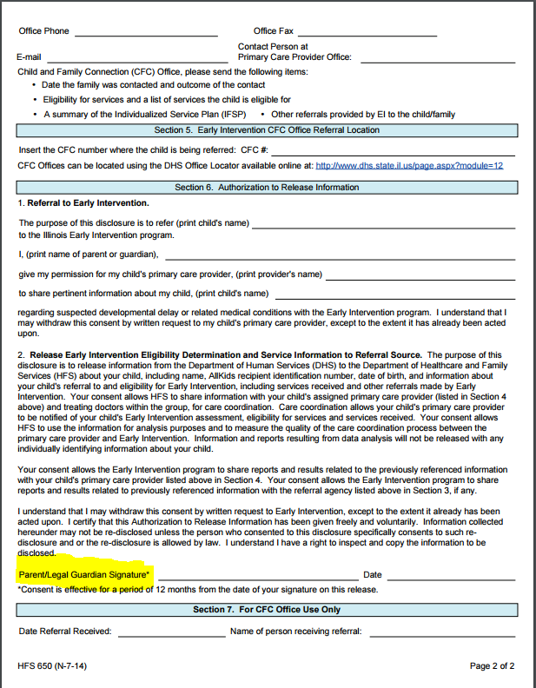
Statewide Tool: Standardized IL Early Intervention Referral Form

Slide 9
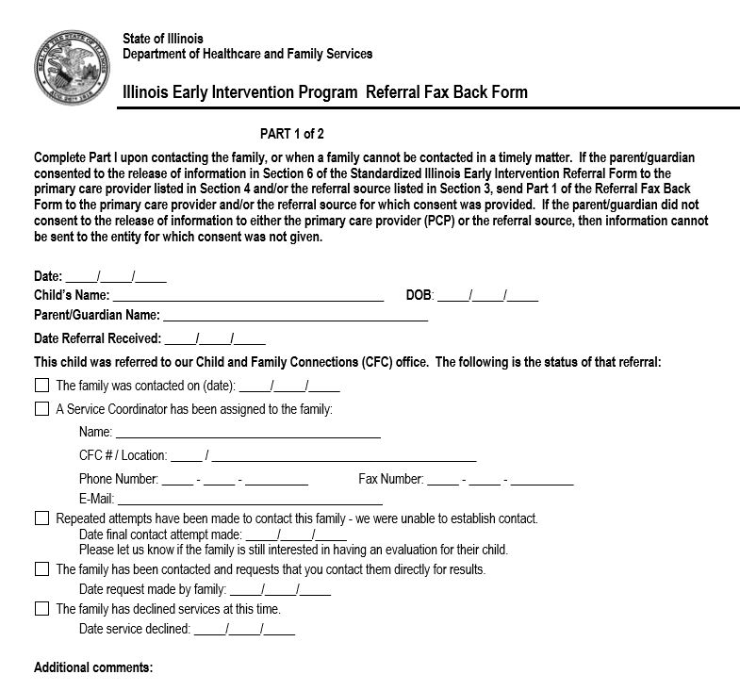
Statewide Tool: EI Referral Fax Back Forms

Slide 10
Public Act 099-0927
Public Act 099-0927
SUPPORTING CHILD HEALTH THROUGH DEVELOPMENTAL AND SOCIAL-EMOTIONAL SCREENINGS
Why are screenings important?
Developmental and social-emotional screenings help to identify children’s needs, leading to earlier intervention where necessary and improved overall health in the long term. Many children have social-emotional and developmental challenges. Screenings can guide families to resources and services that can benefit the child and family.
What does Public Act 099-0927 do?
SB 565 adds developmental and social-emotional screenings to child health examinations that already include dental and vision exams for all children in Illinois. These child health examinations occur during the child’s kindergarten or first grade year, as well as sixth and ninth grades of a child’s K-12 school career. Additionally, child health exams occur before enrollment in child care, nursery school, and whenever out-of-state students enroll in Illinois schools. If the child does not have the screening done by October 15th of the current school year, the child’s school may, with parental consent, complete the screening(s) and help link the child to appropriate services. By incorporating these screenings into the child health examination, SB 565 will also build awareness around developmental and social-emotional health challenges with the ultimate goal of breaking stigma and increasing early identification and intervention.
http://www.ilga.gov/legislation/publicacts/fulltext.asp?Name=099-0927

Slide 11
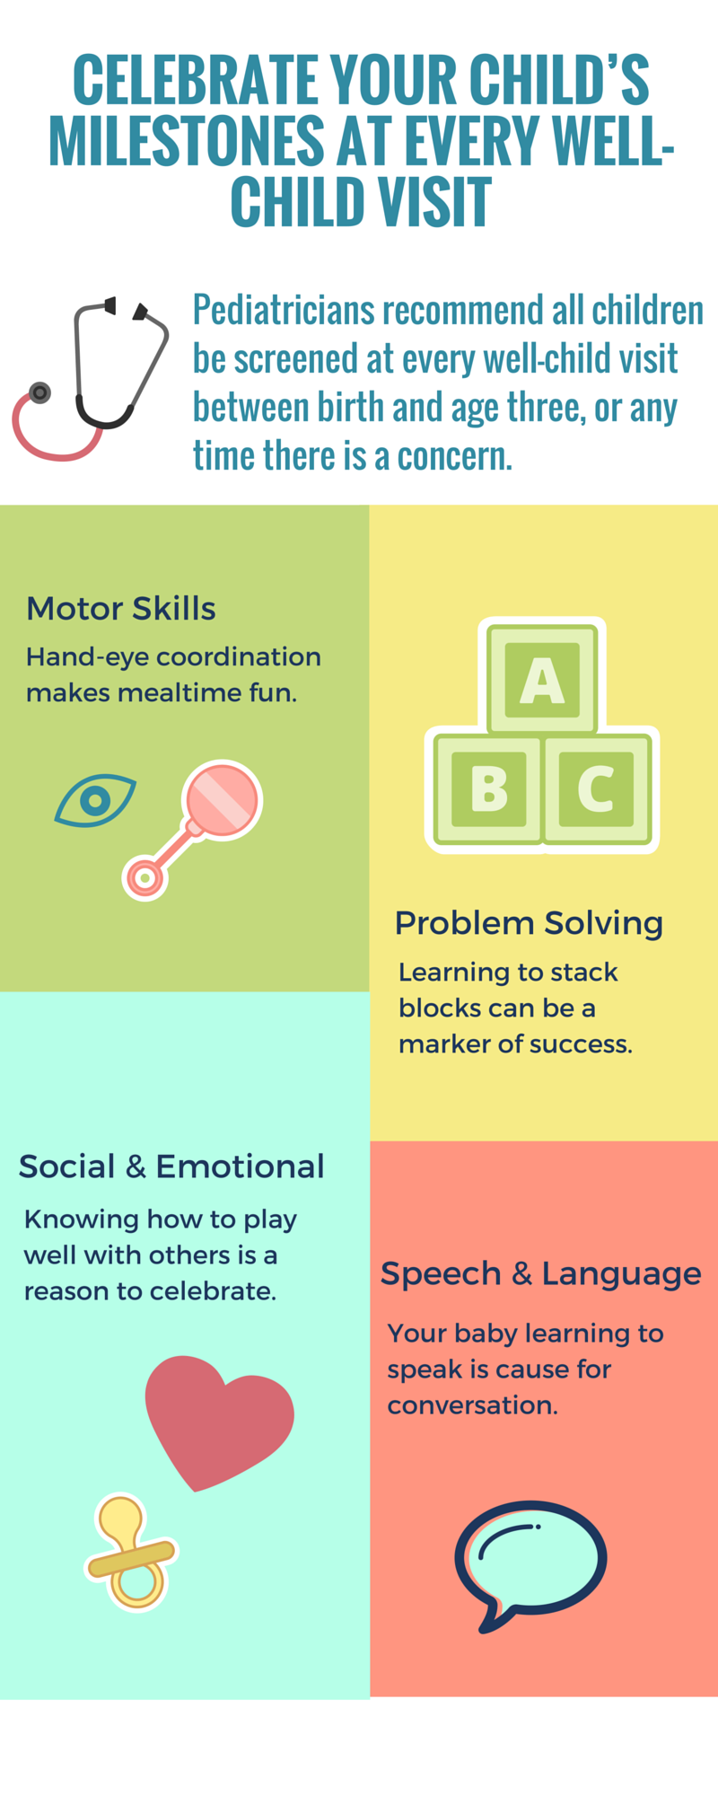
Developmental Screening Resources for Health Care Providers and MCOs
Provider trainings- Importance of developmental screening and appropriate referrals
Care coordinator trainings- Effective and informed methods for outreach and informing enrollees of development screenings
Call Scripts and FAQ’s- To assist care coordinators in demystifying developmental screenings for families
Enrollee mailers- Informing them of developmental screenings
Clinical resource- Presenting best practices for screening and referrals

Slide 12
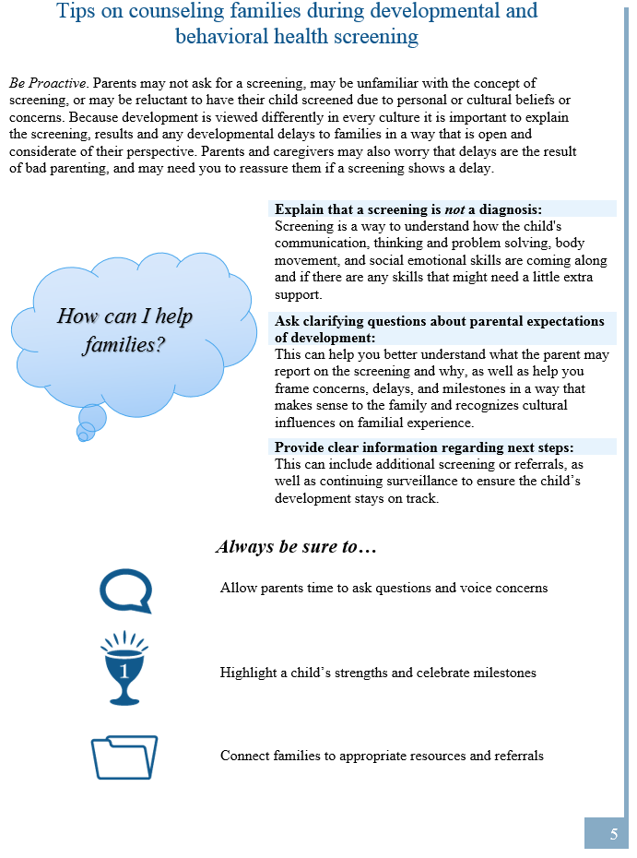
Illinois Health Care Provider Quick Resource Guide: A resource for developmental and behavioral health screenings and referrals of young children

