Slide 1
MAC ‘n BAC:
Comply and Improve
Leo Cuello
October 7, 2024

Slide 2
Out with the old: Medical Care Advisory Committees
Medicaid regulations have required states to operate Medical Care Advisory Committees (MCAC)
MCACs provide feedback and recommendations to the state on how Medicaid operates
MCACs include a wide range of Medicaid stakeholders and must include individuals enrolled in Medicaid
There haven’t been many requirements for state MCACs, so their form and function has been irregular

Slide 3
In with the new: MAC and BAC
The new Access regulation creates a dual committee structure, which fully launches July 2025:
The MCAC is renamed Medicaid Advisory Committee (MAC)
  Starting July 2027, 25% of the MAC must be BAC members
The regulation creates a new Beneficiary Advisory Council (BAC), which will be only enrollee stakeholders and will provide direct advice to the Medicaid agency

Slide 4
MAC
2027
BAC members
BAC
Notes:
Example: So starting 2027, ¼ of the MAC must be BAC members. Let’s say the state has 12 spots on its MAC. That means at least 3 spots must be for BAC members. So that state might have a 15-person BAC, and 3 of those BAC members would also be on the MAC.

Slide 5
What percent of MAC must come from BAC?
10%
20%
25%
Notes:
CMS Technical Correction 06/27/2024
89 Fed Reg 53497
[CMS–2442–CN]
RIN 0938–AU68
Medicaid Program; Ensuring Access to Medicaid Services; Correction
ACTION: Final rule; correction.
On page 40862, first column, fourth
full paragraph, the regulation text for
§ 431.12(d)(1) that reads:
‘‘(1) For the period from July 9, 2024
through July 9, 2025, 10 percent of the
MAC members must come from the
BAC; for the period from July 10, 2025
through July 9, 2026, 20 percent of MAC
members must come from the BAC; and
thereafter, 25 percent of MAC members
must come from the BAC.’’
is corrected to read:
‘‘(1) For the period from July 9, 2025
through July 9, 2026, 10 percent of the
MAC members must come from the
BAC; for the period from July 10, 2026
through July 9, 2027, 20 percent of MAC
members must come from the BAC; and
thereafter, 25 percent of MAC members
must come from the BAC.’’

Slide 6
Mantra: Comply and Improve
The old MCAC will need to come into compliance with new new minimum standards for MACs
BACs will need to be built to minimum requirements
But of course: we want them to do more than the minimum
This work needs to be done by July 2025 – the time to start talking to your state is NOW!!!
What internal state processes need to happen to get this transition done by July 2025?

Slide 7

(1) MAC: Membership
Rule: MAC membership must include at least one: consumer advocacy org, clinical provider, managed care plan, and (ex-officio) other state agency
Your org is the consumer advocacy org!
More than one consumer advocacy org
Clinical provider(s) include: primary care, pediatrician, maternity care
Other state agency: think about HRSN and Medicaid roles

Slide 8
(2) MAC: Meetings
Rule: MAC must meet at least quarterly (note: BAC meets on same schedule), with at least 2 public meetings where they take public comments, with advance notice of meeting and conflict of interest disclosure
Push to six meetings a year. Ten?
All meetings public and with public comment
Develop plan for when and how advance notice is provided

Slide 9
(3) MAC and BAC: Processes and Website
Rule: State needs to make a website with LOADS of MAC/BAC info: Membership/leadership lists, meeting schedules, recruitment processes, bylaws, “standardized processes and practices for administration”, meeting minutes and attendee lists, annual report
Make sure it’s all on state worklist!
Public info/encouragement on how to participate in MAC/BAC
Lists of recommendations

Slide 10
(4) MAC & BAC: Odds & Ends
Rules: State must support MAC production of Annual Report, which includes recommendations and responses. State must accept advice on wide range of topics.
Ensure Annual Report format and process will yield an honest depiction of how the state sought feedback and responded
Get broad, written commitment from state to bring everything important to MAC & BAC; consider specific items that should always be brought—esp. to BAC

Slide 11
(5) BAC: Membership
Rules: State must recruit BAC members who are current and former Medicaid enrollees, including their family/caregivers. State selects term length, consecutive terms prohibited.
Help state develop, and make sure they will publish, recruitment process for membership and leadership
Include standards ensuring diversity of BAC: Medicaid categories, regions of state, race/ethnicity, etc.
Work with state to solve the turnover problem created by rule

Slide 12
(6) BAC: Support
Rules: State must support BAC members’ “meaningful engagement,” including financial support.
Develop equitable policies for reimbursement; consider stipends
Dedicated state point person that is available, engagement-oriented, and accountable
Policies for broad logistics support/resources
Get state to commit to working with BAC support orgs

Slide 13
(7) BAC: Meeting Details
Rules: State must vary meeting formats to maximize attendance and ensure accessibility. At least one member of state executive staff must be present.
Develop optimal plan for meeting formats/location
Secure state commitment and plan on accessibility – at a minimum language and disability
Get state commitment on state staff participation at BAC meetings

Slide 14
Beneficiary Advisory Council Learning Collaborative
Anna Spencer, MPH
Senior Program Officer
Center for Health Care Strategies

Slide 15




Center for Health Care Strategies
Dedicated to strengthening the U.S. health care system to ensure better, more equitable outcomes, particularly for people served by Medicaid.
Together with our partners, our work advances:
  Effective models for prevention and care delivery that harness the field’s best thinking and practices to meet critical needs.
  Efficient solutions for policies and programs that extend the finite resources available to improve the delivery of vital services and ensure that payment is tied to value.
  Equitable outcomes for people that improve the overall well-being of populations facing the greatest needs and health disparities.
Notes:
CHCS is a nonprofit based in New Jersey that works with stakeholders nationally to strengthen health care services to ensure better and more equitable outcomes, particularly for children and adults served by Medicaid.
Since 1995, we have worked in every state in the nation. We partner with state and federal agencies, health plans, providers, community-based organizations, and community members to make health care work better for people who face serious barriers to well-being — barriers like poverty, complex health and social needs and systemic racism.
We work to advance:
More effective models for care delivery;
More efficient policy and program design; and across all our work, we focus on:
More equitable care and opportunities to address the obstacles that stand in the way of health equity for people facing the greatest disparities.
Customize the transition to how specific program/presentation supports the above goals…

Slide 16





CHCS Approach to Work
We partner with Medicaid stakeholders — including state and federal agencies, managed care plans, providers, community-based organizations and consumers — to promote innovations in health care delivery where they are needed most. Through our work, we:
  Identify and advance best practices
  Drive policy improvements with evidence and insights
  Develop the capacity and expertise of health care leaders
  Provide practical training, technical assistance, and tools
  Spread success by connecting peers and experts across sectors
Notes:
Our work with Medicaid stakeholders focuses primarily on five broad strategies to promote innovations in health care delivery where they are needed most.
First and foremost, we are a knowledge organization – we are in the business of identifying and broadly disseminating what is working in the field;
We drive policy improvements. Through expert analysis, we distill evidence and insights to inform state and national policy;
We build leadership capacity. We ensure that health care leaders – at the state, plan, and provider level – have the skills needed to succeed;
We provide practical training, tailored technical assistance and tools to help implement effective policy at the ground-level; and finally
We spread success by helping peers and experts connect across the country to learn from each other.

Slide 17

Beneficiary Advisory Council Learning
Collaborative (BAC LC): Overview
Led by CHCS, with key technical assistance partners
Core Participants: Seven state teams developing or strengthening a Medicaid Beneficiary Advisory Council (BAC)
Aligned with the final Centers for Medicare & Medicaid Services (CMS) rule requiring states to establish a BAC, and center lived experience in the design and implementation of Medicaid programs and policies

Slide 18
BAC LC Participants
ME
WA
VT
MT
ND
MN
NY
NH
OR
ID
SD
WI
MI
MA
WY
PA
IA
OH
RI
NE
IN
NV
IL
WV
VA
CT
CA
UT
CO
KY
KS
MO
NC
NJ
TN
DE
OK
SC
AZ
NM
AR
MD
AL
GA
MS
DC
TX
LA
HI
FL
AK
PR

Slide 19




Learning Collaborative Goals
Build states’ understanding of member engagement and advisory group promising practices
Support states in partnering with a community entity and Medicaid members to refine or develop BAC
Facilitate internal culture change to increase organizational commitment and capacity related to the Medicaid Advisory Committee (MAC) and BAC
Build internal staff capacity to ensure MAC/BAC input is translated into program and policy design

Slide 20
Planned Activities
Member engagement landscape assessment
  Catalog existing Medicaid member engagement strategies and mechanisms
Partnership with community entity or entities
  Regrants of $25,000 to the community entity to support action plan coordinating efforts, including compensating Medicaid members
Developing a BAC implementation action plan
  Concrete timeline/steps to implement a BAC, in partnership with the community entity and Medicaid members
BAC implementation
  Align BAC with final CMS rule and include structures and processes to ensure member feedback is meaningfully integrated into policymaking
  July 2025 Launch
Notes:
Participating state teams will be expected to partner with a community entity or entities to bring lived experience to the creation of the Medicaid member advisory group action plan and its implementation.
The Medicaid member advisory group action plan will identify the steps necessary to implement or strengthen the member advisory group, in accordance with upcoming CMS rules. The plan, developed in partnership with Medicaid members, will include advisory group goals, timelines, and accountability structures, and will articulate early milestones for launching or strengthening the advisory group with related measures of success. These could include outreach and enrollment of advisory board members, developing a compensation policy, formalizing accountability mechanisms to ensure member input is integrated into decision-making, and the co‑development of a group charter.
Implementing the Medicaid member advisory group. State participants will be expected to implement or strengthen a Medicaid member advisory group in partnership with the community entity and Medicaid members. The group should align with the final CMS rules and include structures and processes to ensure that member feedback is meaningfully integrated into program and policymaking.

Slide 21
Community Partner Opportunities
States required to partner with a community entity/entities to bring lived experience into the BAC design and implementation process
Many states will release an “Opportunity for Engagement”
Project period ~December 2024-July 2025
Required capabilities to be determined by the state, but may include:
  Ability to recruit a diverse set of Medicaid members to participate in BAC planning and implementation efforts;
  Ability to convene Medicaid members (e.g., listening sessions, focus groups, or other facilitated session)
  Organizational capacity and infrastructure to compensate members for their time and expertise
  Ability to provide necessary accommodations and supports to members to ensure their active participation (i.e., technology support, meals, childcare, etc.)

Slide 22
Q&A

Slide 23
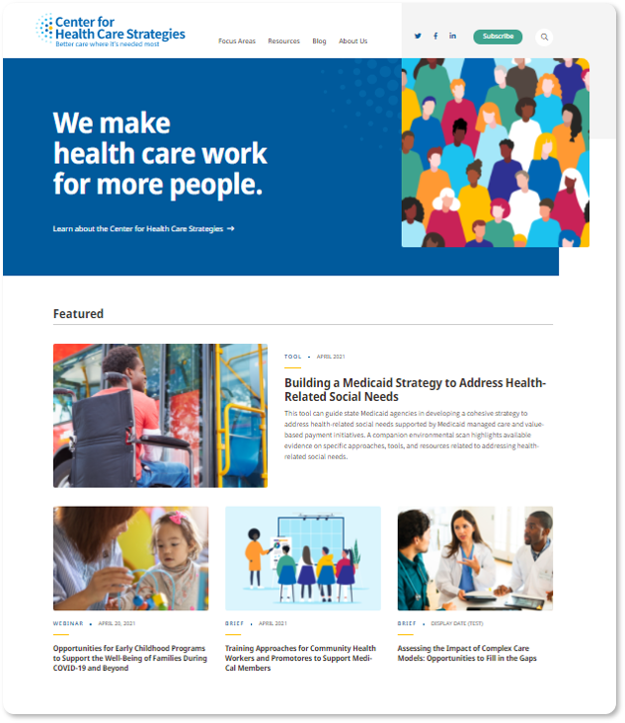
Visit CHCS.org to…
Download practical resources to improve
health care for people served by Medicaid.
Learn about cutting-edge efforts from
peers across the nation to enhance policy,
financing, and care delivery.
Subscribe to CHCS e-mail updates, to learn
about new resources, webinars, and more.
Follow us on LinkedIn or Twitter @CHCShealth.

