Slide 1
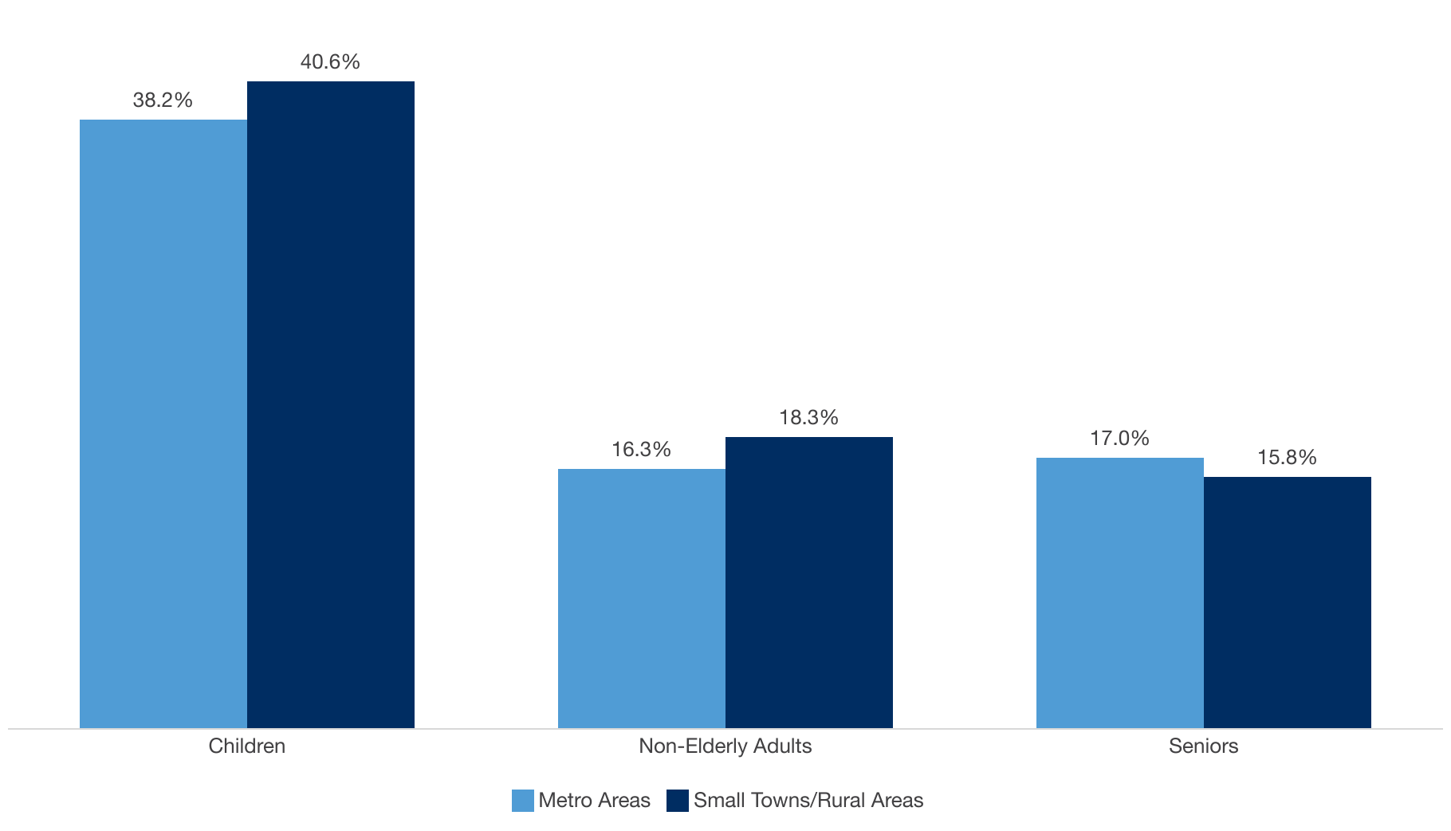
Medicaid Coverage in Metro Areas and Small Towns/Rural Areas, 2023
Note: “Small Towns/Rural Areas” include counties with no urban areas of at least 50,000 residents. The District of Columbia, New Jersey, and Rhode Island have no counties classified as Small Towns/Rural Areas.
Source: County-level Medicaid/CHIP coverage estimates are based on an analysis of 2022-2023 American Community Survey (ACS) Public Use Microdata Sample (PUMS).
Notes:
The totals are 21.6% for metro and 22.9% for rural

Slide 2
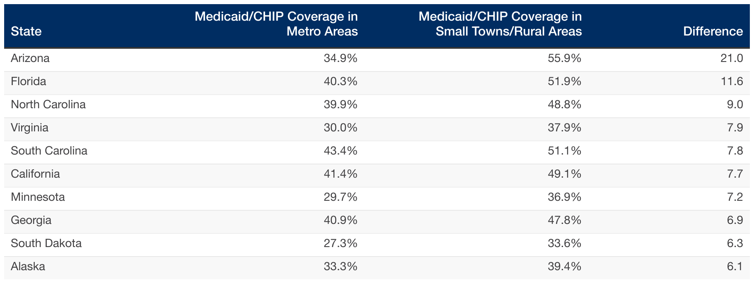
Top 10 States with Largest Difference in the Share of Children Covered by Medicaid/CHIP in Small Towns/Rural Areas v Metro Areas, 2023
Note: “Small Towns/Rural Areas” include counties with no urban areas of at least 50,000 residents. The District of Columbia, New Jersey, and Rhode Island have no counties classified as Small Towns/Rural Areas.
Source: County-level Medicaid/CHIP coverage estimates are based on an analysis of 2022-2023 American Community Survey (ACS) Public Use Microdata Sample (PUMS).

Slide 3
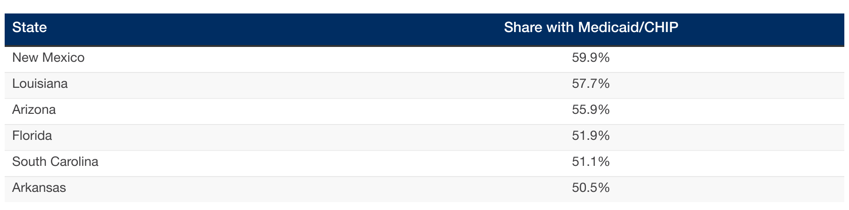
States with at Least Half of Children in Small Towns/Rural Areas Covered by Medicaid/CHIP, 2023
Note: “Small Towns/Rural Areas” include counties with no urban areas of at least 50,000 residents. The District of Columbia, New Jersey, and Rhode Island have no counties classified as Small Towns/Rural Areas.
Source: County-level Medicaid/CHIP coverage estimates are based on an analysis of 2022-2023 American Community Survey (ACS) Public Use Microdata Sample (PUMS).

Slide 4
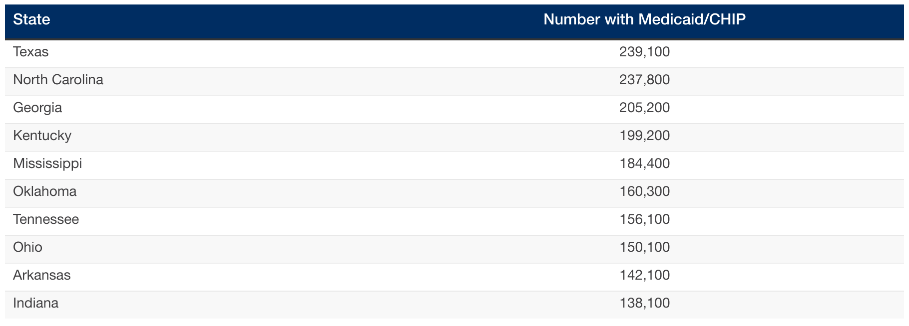
Top 10 States with Highest Numbers of Children Covered by Medicaid/CHIP in Small Towns/Rural Areas, 2023
Note: “Small Towns/Rural Areas” include counties with no urban areas of at least 50,000 residents. The District of Columbia, New Jersey, and Rhode Island have no counties classified as Small Towns/Rural Areas.
Source: County-level Medicaid/CHIP coverage estimates are based on an analysis of 2022-2023 American Community Survey (ACS) Public Use Microdata Sample (PUMS).

Slide 5
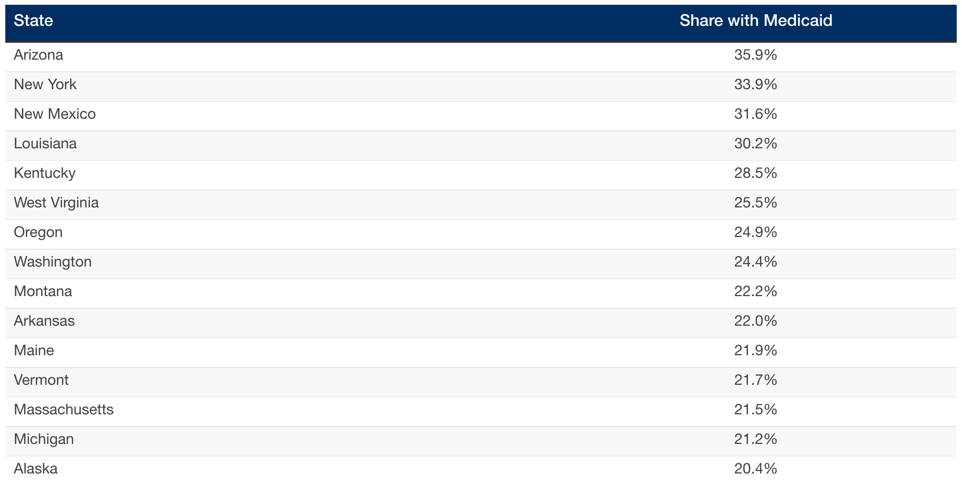
15 States Have at Least 20% of Non-Elderly Adults in Small Towns/Rural Areas Covered by Medicaid, 2023
Note: “Small Towns/Rural Areas” include counties with no urban areas of at least 50,000 residents. The District of Columbia, New Jersey, and Rhode Island have no counties classified as Small Towns/Rural Areas.
Source: County-level Medicaid/CHIP coverage estimates are based on an analysis of 2022-2023 American Community Survey (ACS) Public Use Microdata Sample (PUMS).

Slide 6
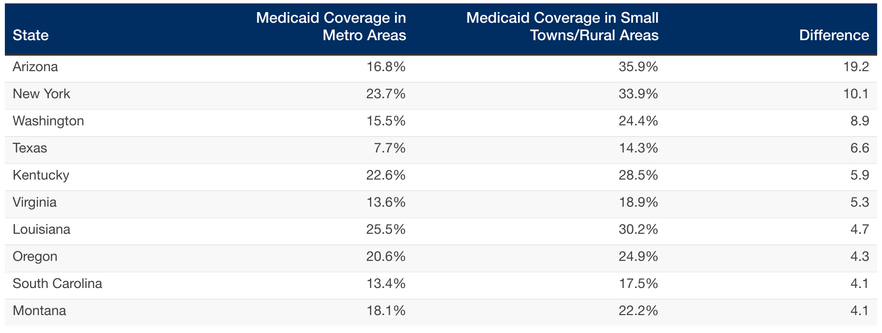
Top 10 States with the Largest Difference in the Share of Non-Elderly Adults Covered by Medicaid in Small Towns/Rural Areas and Metro Areas, 2023
Note: “Small Towns/Rural Areas” include counties with no urban areas of at least 50,000 residents. The District of Columbia, New Jersey, and Rhode Island have no counties classified as Small Towns/Rural Areas.
Source: County-level Medicaid/CHIP coverage estimates are based on an analysis of 2022-2023 American Community Survey (ACS) Public Use Microdata Sample (PUMS).

Slide 7
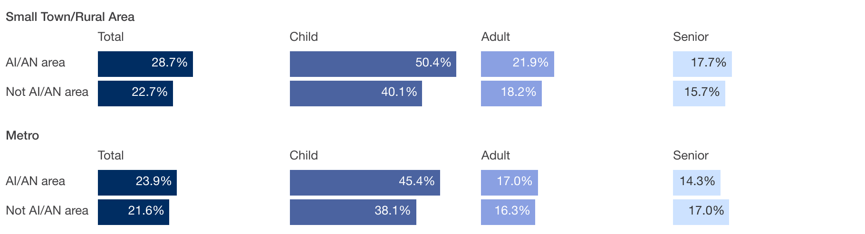
Medicaid Coverage in Metro Areas and Small Towns/Rural Areas by County Location in American Indian and Alaska Native Area (AI/AN), 2023
Note: “Small Towns/Rural Areas” include counties with no urban areas of at least 50,000 residents. The District of Columbia, New Jersey, and Rhode Island have no counties classified as Small Towns/Rural Areas. AI/AN counties defined as those where at least 50 percent of the county falls within areas including Tribal and Village Statistical Areas, Tribal Subdivisions, American Indian Reservations and Off-Reservation Trustlands, American Indian Joint Use Areas, Alaska Native Regional Corporations, and Hawaiian Home Lands.
Source: County-level Medicaid/CHIP coverage estimates are based on an analysis of 2022-2023 American Community Survey (ACS) Public Use Microdata Sample (PUMS).

Slide 8
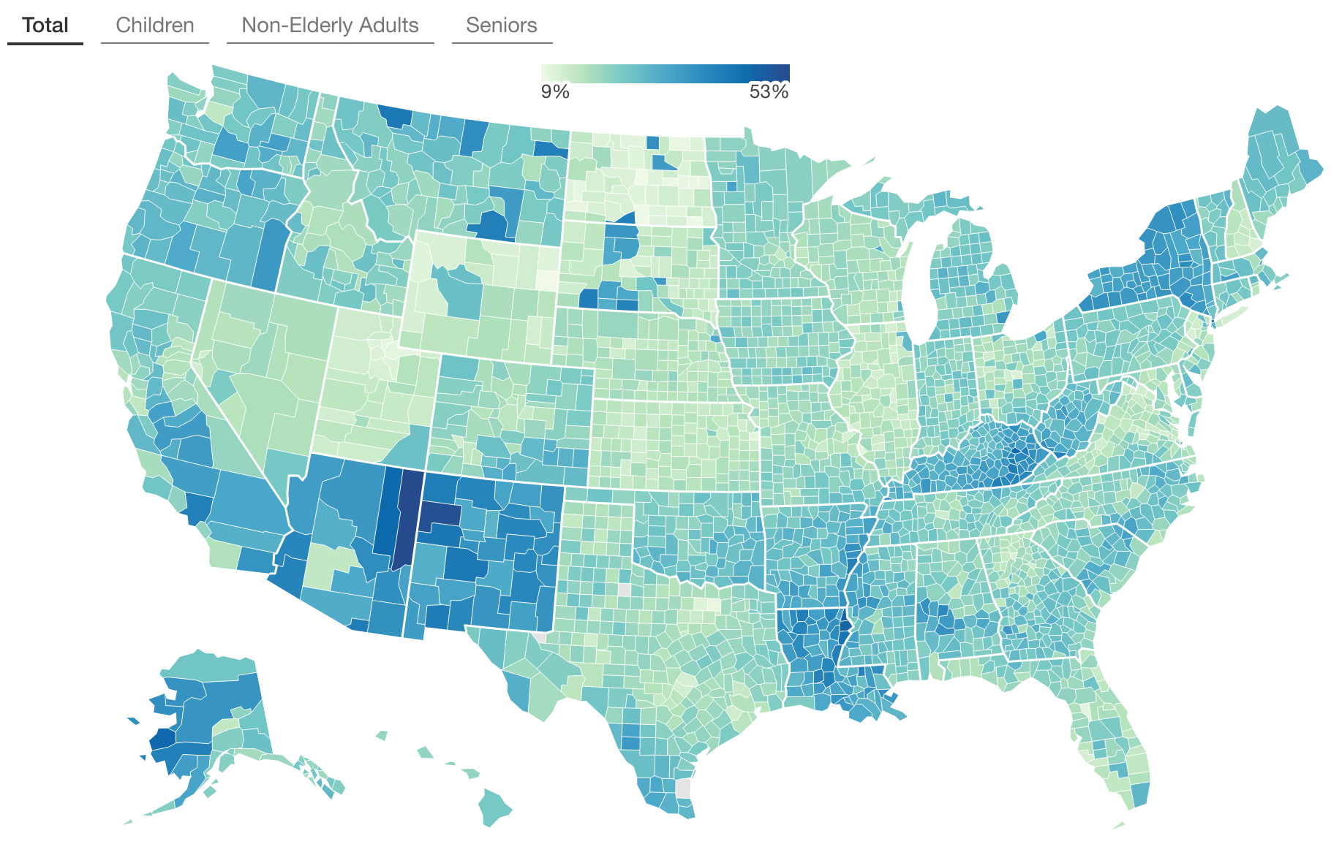
Medicaid Coverage in Metro and Small Town/Rural Area Counties, 2023
Note: “Small Towns/Rural Areas” include counties with no urban areas of at least 50,000 residents. The District of Columbia, New Jersey, and Rhode Island have no counties classified as Small Towns/Rural Areas. Counties marked N/A are suppressed due to poor reliability.
Source: County-level Medicaid/CHIP coverage estimates are based on an analysis of 2022-2023 American Community Survey (ACS) Public Use Microdata Sample (PUMS).

Slide 9
For More Information:
THANK YOU!
Contact:
Joan.Alker@Georgetown.edu
Twitter/X:
@georgetownccf
@JoanAlker1
Bluesky:
joanalker1.bsky.social

