Slide 1
The Origins of Medicaid Provider Tax Rules
Andy Schneider
Research Professor of the Practice
Georgetown University Center for Children and Families
April 23, 2025

Slide 2
What is a Medicaid Provider Tax?
Medicaid is a public health insurance program in which the federal and state governments share in the cost.
The federal government matches state spending for covered services furnished to eligible individuals at specified rates.
States have historically had considerable flexibility in how they raise their share of Medicaid’s cost.
Under longstanding federal statutory and regulatory provisions, taxes on providers are one source of revenues a state can use to pay its share.

Slide 3
Federal Rules on Sources of State Share in the 1980s
Public funds that are not Federal could count as state share if they were:
appropriated directly to the state Medicaid agency
transferred from other public agencies to the state Medicaid agency and under its administrative control (IGT); or
certified by the contributing public agency as representing expenditures that are federally matchable (CPEs).
Funds donated from private sources could count as state share if they
were transferred to the state Medicaid agency and under its administrative control; and
the private funds did not revert to the donor’s facility or use unless the donor was a non-profit organization
There were no rules relating to revenues raised from taxes on providers

Slide 4
Medicaid Voluntary Contribution and Provider-Specific Tax Amendments of 1991 (P.L. 102-234)
Effectively prohibits state use of provider-related donations as a source of state share (except when paying for outstationed eligibility workers)
Permits state use of IGTs and CPEs as sources of state share
Permits state use of revenues from taxes on providers as a source of state share if the tax is:
(1) “broad-based” and
(2) no “hold harmless” provision is in effect
Revenues from taxes not meeting these requirements are to be deducted from a state’s expenditures before calculating the amount of federal matching payments

Slide 5
1991 Statutory Rules for Provider Taxes
(Section 1903(w) Social Security Act)
The classes of providers to which the tax rules apply include hospitals, nursing facilities, intermediate care facilities for individuals with intellectual disabilities, physicians, and managed care organizations
Taxes include licensing fees, assessment, or other mandatory payments
To qualify as "broad-based," a provider tax must be (1) imposed uniformly (2) with respect to all non-Federal, nonpublic providers in the class. (The Secretary has the authority to waive the "broad-based" requirements if the tax is "generally redistributive.")
A "hold harmless" provision is in effect if the state or local government imposing the tax provides for any payment, offset or waiver that (directly or indirectly) guarantees to hold a provider harmless for any portion of the costs of the tax.

Slide 6
1992 Implementing Regulation
(42 CFR 433.50-433.74)
Establishes statistical tests for waivers of the “broad-based” and “uniformly imposed” requirements
Stipulates that “hold harmless” provisions are not in effect if the tax produces revenues less than or equal to 6 percent of a provider’s net patient revenues (“safe harbor threshold”)
Adds provider tax classes (currently 19 categories)
Largely unchanged since 1992 (from 2008-2011, safe harbor threshold lowered to 5.5 percent)

Slide 7
Key Facts about Medicaid Provider Taxes
Robin Rudowitz
Director, KFF Program on Medicaid and the Uninsured

Slide 8
Medicaid Provider Taxes
Overview
What are provider taxes
Use of provider taxes across the states
Federal rules on provider taxes
Use of provider taxes by type of provider
Provider tax levels
Possible policy changes and implications
What we don’t know
Total revenues from provider taxes
Effects of taxes on net payment rates
Uses of tax revenues by states
Understanding the current landscape

Slide 9
All states except for Alaska use provider taxes to help finance the state share of Medicaid spending.
States have flexibility in determining how to finance the non-federal share of state Medicaid payments
State fiscal year (FY) 2024:
68% of state Medicaid spending came from general funds
32% from other sources including provider taxes
Provider taxes are those where >= 85% of tax burden falls on services or entities that provide or pay for health care
States use provider tax revenues for:
Base payments to providers
Supplemental payments to providers
Coverage expansions (including the Affordable Care Act expansion group)
Provider taxes may also benefit providers who see a high volume of Medicaid patients

Slide 10
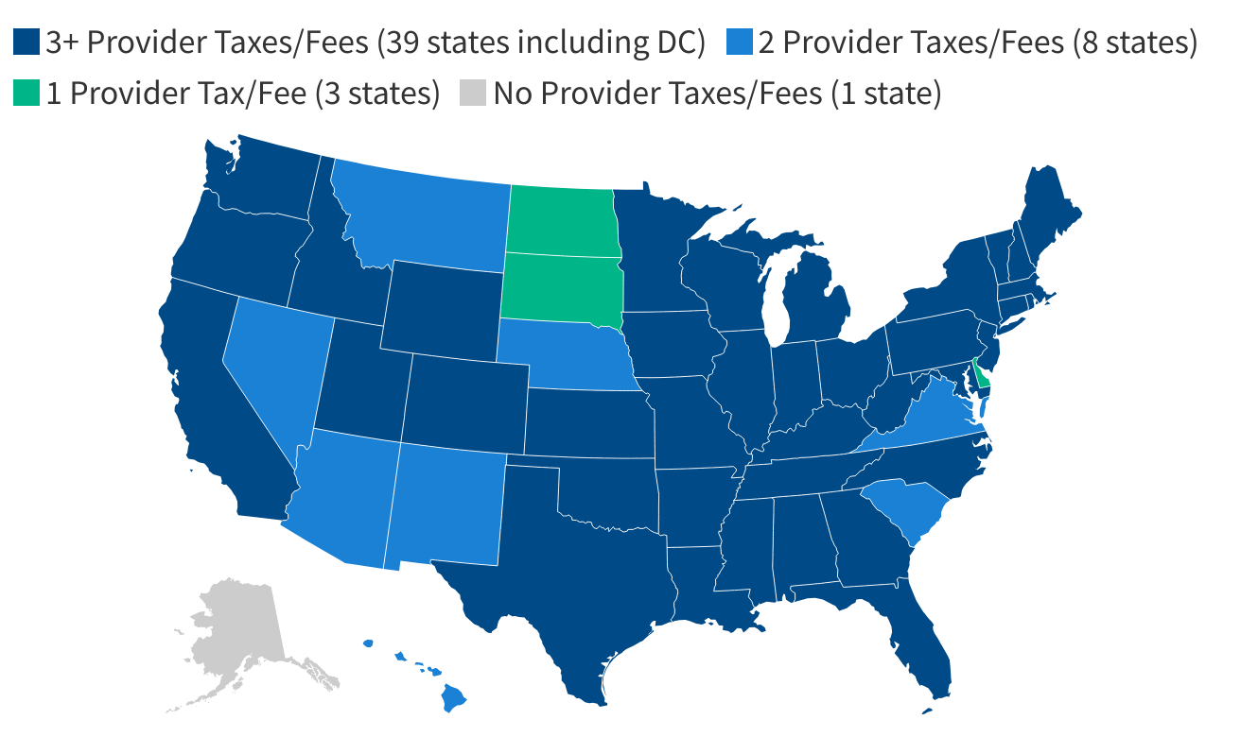
Most states had 3+ provider taxes in SFY 2024.
Notes: SFY = state fiscal year. Includes Medicaid provider taxes as reported by states; refer to source for additional information about types of provider taxes in place. FL did not respond to the 2024 survey; publicly available data used to verify taxes in place. Source: Annual KFF survey of state Medicaid officials conducted by Health Management Associates, October 2024

Slide 11
Federal rules set limits on how states can use provider taxes.
Started in the 1980s with no federal rules and some particularly aggressive use among some states
Rules established starting in the 1990s
Currently, provider taxes must be:
Broad- based = imposed on all providers within a specified class
Uniform = apply equally to all providers within the class
NOT hold harmless = states can’t guarantee that providers will receive their tax revenues back
Exceptions to the rules:
Hold harmless limit does not apply if tax revenues are <=6% net patient revenues, known as “safe harbor limit”
States may receive waivers of the requirement that taxes be broad-based and unform

Slide 12
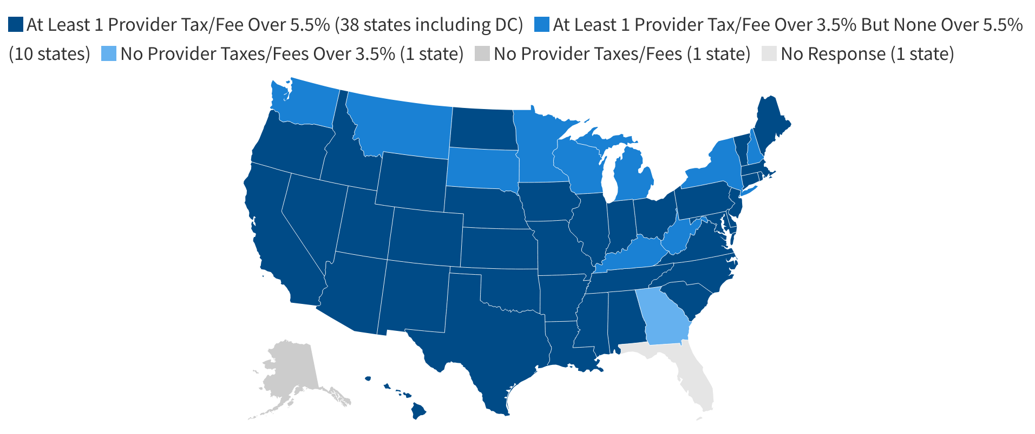
38 states have at least one provider tax that exceeds 5.5% of net patient revenues
Size of provider taxes/fees as a percentage of net patient revenue in SFY 2024
Notes: SFY = state fiscal year. Includes Medicaid provider taxes as reported by states. FL did not respond to the 2024 survey; publicly available data used to verify taxes in place but not the size of the taxes. Source: KFF’s annual survey of state Medicaid officials and 5 Key Facts About Medicaid and Provider Taxes

Slide 13
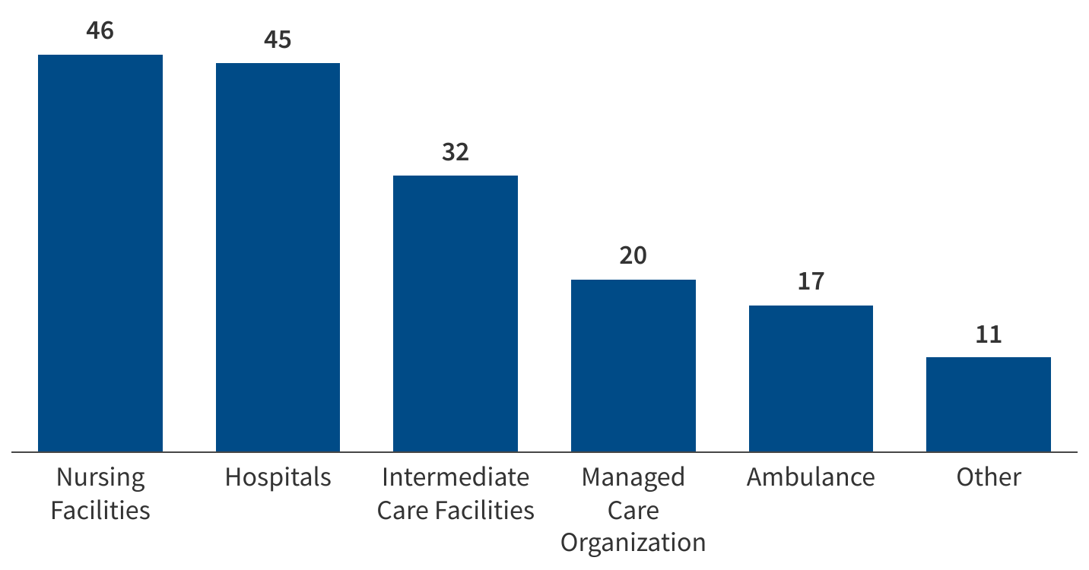
Provider taxes are most common for institutional providers.
Count of states with a provider tax in place by type of provider
Source: KFF’s annual survey of state Medicaid officials and 5 Key Facts About Medicaid and Provider Taxes

Slide 14
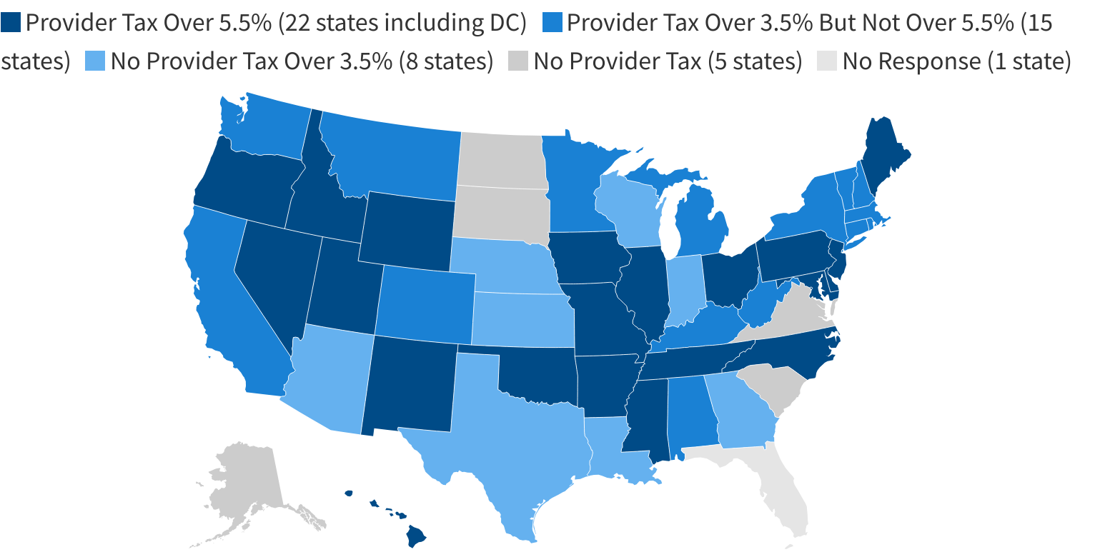
Almost half of states have provider taxes near the safe harbor limit for nursing facilities.
Size of provider taxes/fees for nursing facilities as a percentage of net patient revenue in SFY 2024
Source: KFF’s annual survey of state Medicaid officials and 5 Key Facts About Medicaid and Provider Taxes

Slide 15
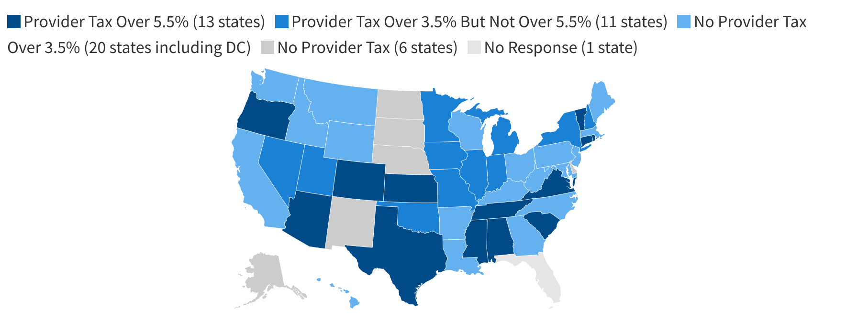
13 states have provider taxes near the safe harbor limit for hospitals.
Size of provider taxes/fees for hospital as a percentage of net patient revenue in SFY 2024
Source: KFF’s annual survey of state Medicaid officials and 5 Key Facts About Medicaid and Provider Taxes

Slide 16
States often use provider tax revenues to support payment rates for hospitals, providers, and institutional providers.
In 2022, 40% of Medicaid hospital spending came from supplemental or state-directed payments
Base payment rates for providers may fall below providers costs
States supplement those payments with lump sum payments such as:
Disproportionate share hospital payments (DSH)
Upper payment limit (UPL)
State-directed payments (SDPs)
Significant policy interest in SDPs on account of recent growth
MACPAC May 2024, Medicaid Base and Supplemental Payments to Hospitals, https://www.macpac.gov/publication/medicaid-base-and-supplemental-payments-to-hospitals/

Slide 17
Policy options are to reduce the safe-harbor threshold for provider taxes.
CBO's estimated change in federal Medicaid spending over 10-years from reducing the safe-harbor threshold for provider taxes, relative to Medicaid spending cuts targeted in the House Budget Resolution
Source: Congressional Budget Office (CBO), Options for Reducing the Deficit: 2025 to 2034: Limit State Taxes on Health Care Providers

Slide 18
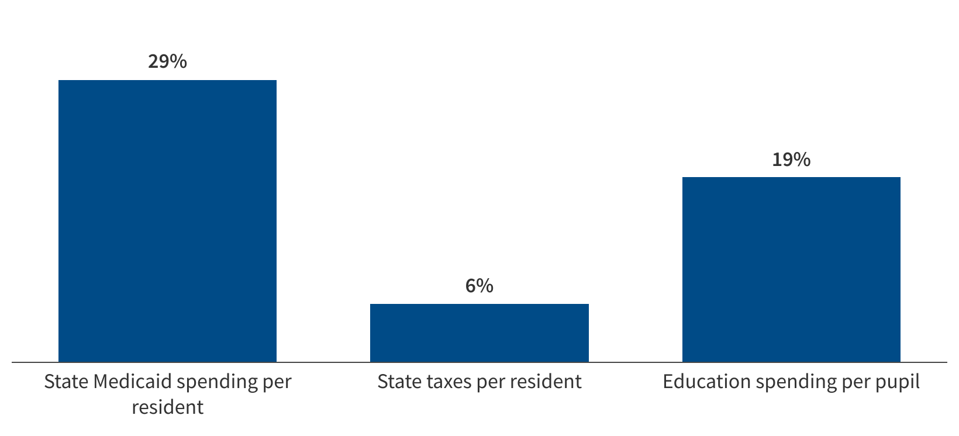
Potential federal Medicaid cuts represent 29% of state Medicaid spending per resident, 6% of state taxes per resident, and 19% of education spending per pupil.
$88B in annual federal cuts as a share of state Medicaid spending per resident, state taxes per resident, and state education spending per pupil
Source: KFF analysis of 2024 Medicaid spending and enrollment data, U.S. Census Bureau 2024 Resident Population Data, U.S. Census Bureau 2023 Annual Survey of State Government Tax Collections, National Association of State Budget Officers (NASBO) 2024 State Expenditure Report, National Center on Education Statistics Digest of Education Statistics, K-12 Enrollment. See Putting $880 Billion in Potential Federal Medicaid Cuts in Context of State Budgets and Coverage for more information.

Slide 19
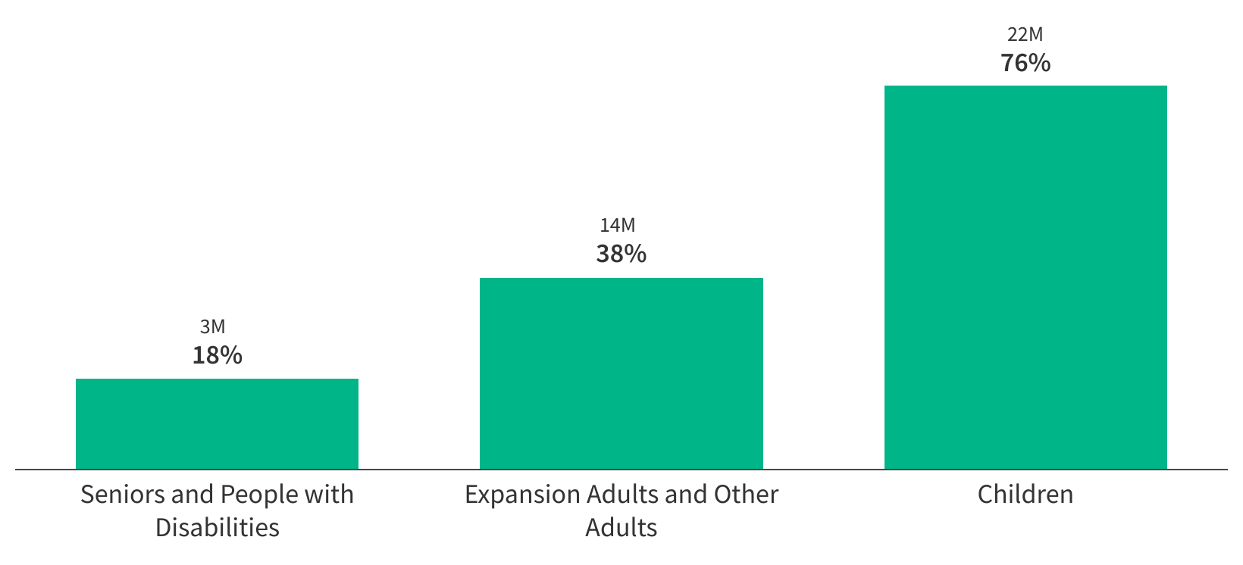
Potential federal Medicaid cuts are equivalent to Medicaid spending for 18% of seniors and people with disabilities, 38% of adults, or 76% of children
Number and share of enrollees in each group equivalent to $88B in federal cuts based on total spending per enrollee
Source: KFF analysis of 2024 Medicaid enrollment and spending data. See Putting $880 Billion in Potential Federal Medicaid Cuts in Context of State Budgets and Coverage for more information.

Slide 20
THANK YOU
For more information, contact: robinr@kff.org

Slide 21
Proposals to Restrict or Eliminate State Use of Provider Taxes to Finance Medicaid
Edwin Park
Research Professor
Georgetown University Center for Children and Families
April 23, 2025

Slide 22
Possible Congressional GOP Proposals to Eliminate or Restrict State Use of Provider Taxes
Lower safe harbor tax threshold for hold harmless requirement from current threshold of 6% of net patient revenues
Proposal in House Budget Committee’s reconciliation menu would lower safe harbor threshold to 4% in 2026 and 3% in 2028 and thereafter
Would affect 39 states + D.C. that have at least one tax of 5.5% or higher and by 2028, affect 48 states + D.C. that have at least one tax of 3.5% of patient revenues or higher
Other possible proposals
Eliminate safe harbor entirely
Restrict statistical test waivers of broad-based and uniform requirements
Restrict state-directed payments financed by provider taxes

Slide 23
CBO Estimates of Eliminating or Restricting Provider Taxes
Congressional Budget Office has estimated impact of illustrative provider tax proposals related to changes to the current 6% of patient revenues safe harbor threshold for satisfying the hold harmless requirement
Lowering safe harbor to 5%: cut of $48 billion/10 years
Lowering safe harbor to 2.5%: cut of $241 billion/10 years
Eliminating safe harbor entirely: cut of $612 billion/10 years

Slide 24
How Restrictions or Elimination of Provider Taxes Reduce Federal Spending
Why CBO finds these safe harbor proposals reduce federal spending:
Assumes states would be able to replace, on average, no more than half of the provider tax revenues lost
Includes impact of state behavior in response, such as dropping the Medicaid expansion, cutting provider payments, cutting optional benefits, and non-expansion states not adopting the expansion in the future
New provider taxes or increases in existing provider taxes have often been paired with adoption of the Medicaid expansion including in North Carolina (the most recent state to take up the expansion)

Slide 25
Context: Other Medicaid Cut Proposals Shift Significant Costs to States
Many of the major Medicaid cut proposals under discussion involve reducing federal Medicaid funding and therefore shifting significant costs to states. Examples:
Per capita caps
Elimination of the 90% expansion matching rate
Federal Medicaid funding accounts for majority of all federal funding in state budgets
Source: CCF analysis of National Association of State Budget Officers (NASBO) data for state fiscal year 2024 (estimated).

Slide 26
How Provider Tax Restrictions Would Interact with Other Medicaid Spending Cuts
Restriction or elimination of provider taxes at the same time would make it far harder to maintain current state spending on Medicaid, let alone raise substantially increased revenues to compensate for losses in federal Medicaid funding
States would have to dramatically raise taxes or severely cut other parts of their budget, especially K-12 education and higher education, which constitutes 43% of general fund budgets
It’s far more likely that states will have to make deep, damaging cuts to their Medicaid programs in the areas of eligibility, benefits and provider and plan payment rates
Why cuts affecting federal and state Medicaid financing including provider tax restrictions are attractive to federal policymakers:
They may claim they are not making explicit cuts to eligibility, benefits and provider payments (work requirements are a notable exception)
But these types of proposals leave states holding the bag. Governors and state legislatures are given no choice but to make politically painful, very large cuts to their Medicaid programs

Slide 27
For More Information
Medicaid Provider Taxes: A Critical Source of Medicaid Funding for States (CCF, February 2025)
5 Key Facts About Medicaid and Provider Taxes (KFF, March 2025)
Health Care-Related Taxes in Medicaid (MACPAC, May 2021)

