Slide 1
How Medicaid Supports Early Childhood Educators
May 1, 2025

Slide 2
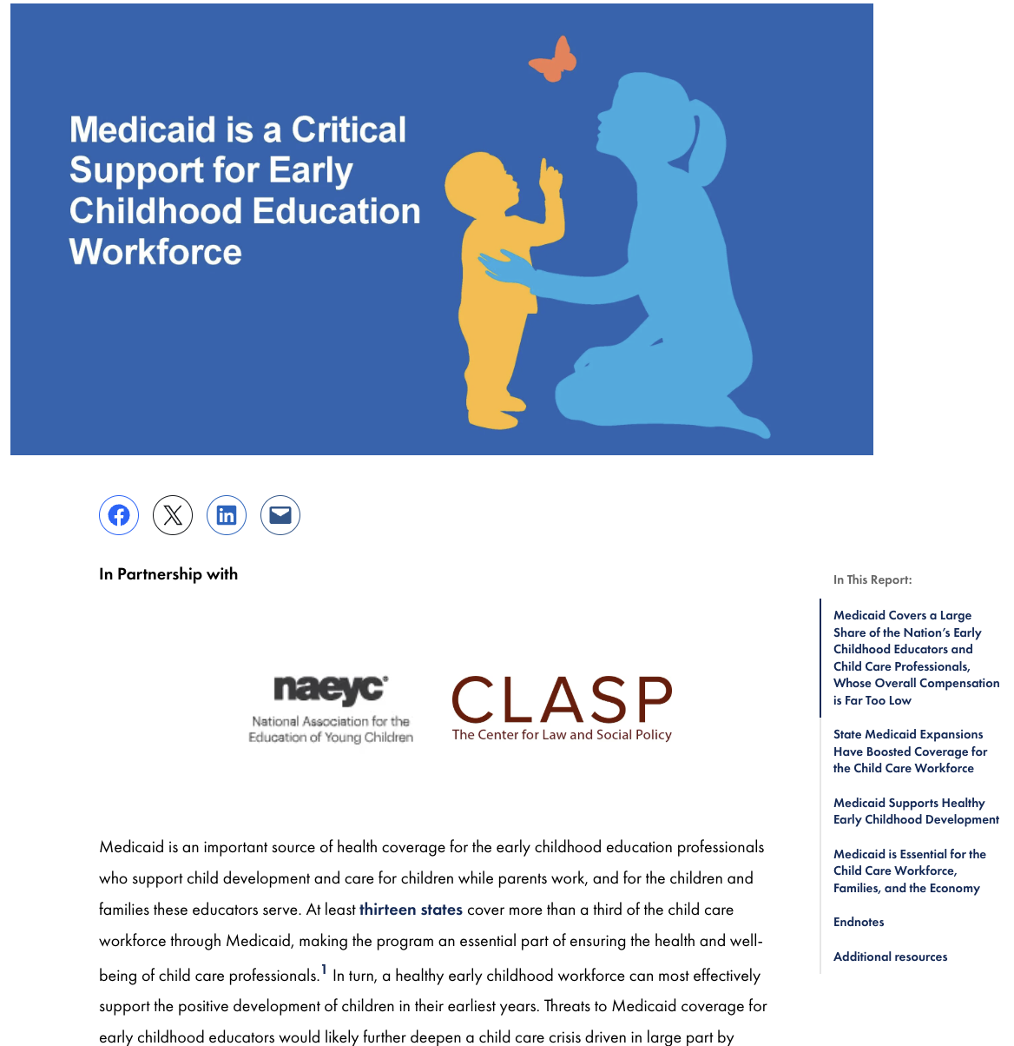
Today’s Plan
Medicaid Overview
Medicaid Coverage for Early Childhood Educators
Congressional Medicaid Proposals
How would Medicaid cuts impact the existing child care crisis?
Perspective from the Field: Virginia
Panel discussion, Audience Q&A
Read the new brief here!
Notes:
NOT talking about ED proposals or EI only Medicaid’s role supporting EI
for more information see other CCF webinars and resources

Slide 3
Our Speakers
Elisabeth Wright Burak, Georgetown CCF
Julie Kashen,
The Century Foundation
Daniel Hains,
NAEYC
Angel Cummings,
Early Childhood Advocate
Suzanne Wikle,
CLASP

Slide 4
Medicaid’s Many Roles
Medicaid/CHIP provide health coverage for close to:
Half of all children 0-19
99% of children in foster care
Half of children with special health care needs (CSHCN)
40 - 50% of all births
28% of child care workers
Largest funder of long-term care services, substance abuse treatment, mental health services
Medicaid plays a key role in:
Rural communities
Pandemics and natural disasters
Notes:
Thank you to CLASP, NAEYC for their partnership. This is a consequential time for families, and in the history of so many public programs that support them, including Medicaid. At CCF we have been looking more deeply at ways Medicaid supports children and their families in sectors or areas that may not be as familiar. Sector briefs: Child welfare, EI, for children with disabilities, caregivers, etc.
50 states/DC; Puerto Rico/US territories
$951 billion in federal funding in 2024
Health insurance for 80 million Americans
Tens of thousands of individual doctors and health care practitioners, hospitals, nursing facilities, other institutional providers
Hundreds of managed care organizations

Slide 5
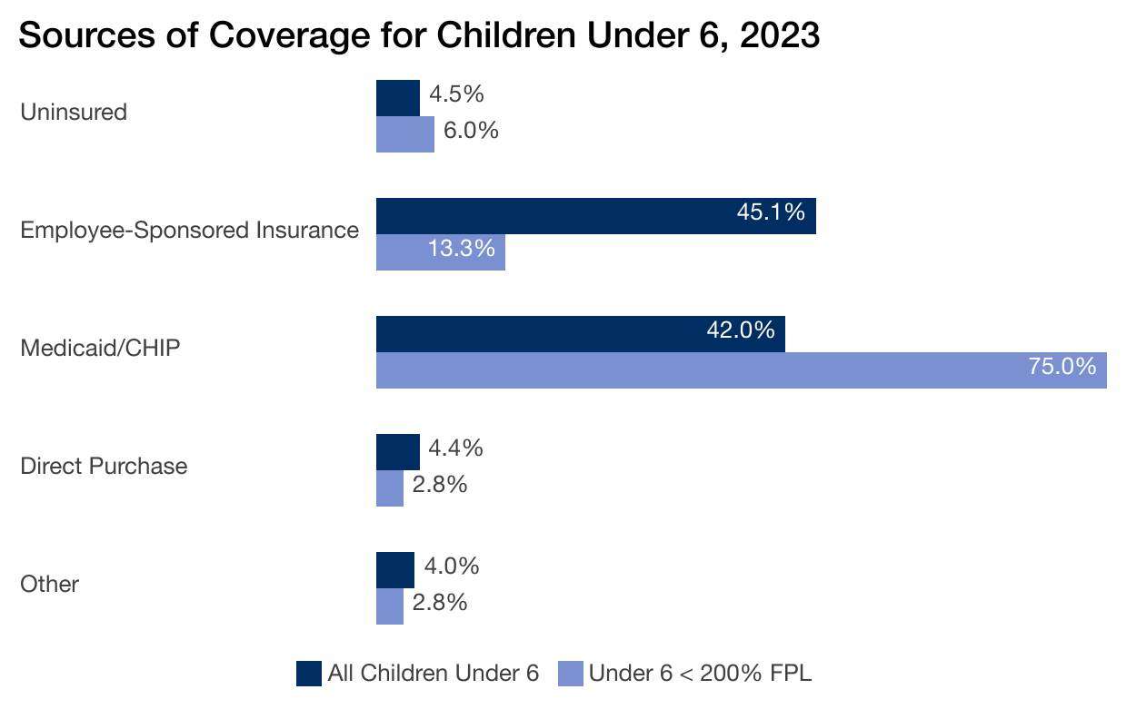
Source: Georgetown University Center for Children and Families analysis of U.S. Census Bureau 2023 American Community Survey (ACS) Public Use Microdata Sample (PUMS).
Notes:
IN thinking about the early childhood world, I’d be remiss if I didn’t remind folks that Medicaid and CHIP are THE major source of healeth coverage for low=income children under 6 – 3 out of 4. Looking to uninsured $ at top– Medicaid has been the major workhorse, along with CHIP, to drive rate of uninsurance to lowest levels on record for kids in crescent years.
Medicaid/CHIP is the largest for low-income children under 6 - these #s likely undercount medicaid coverage

Slide 6
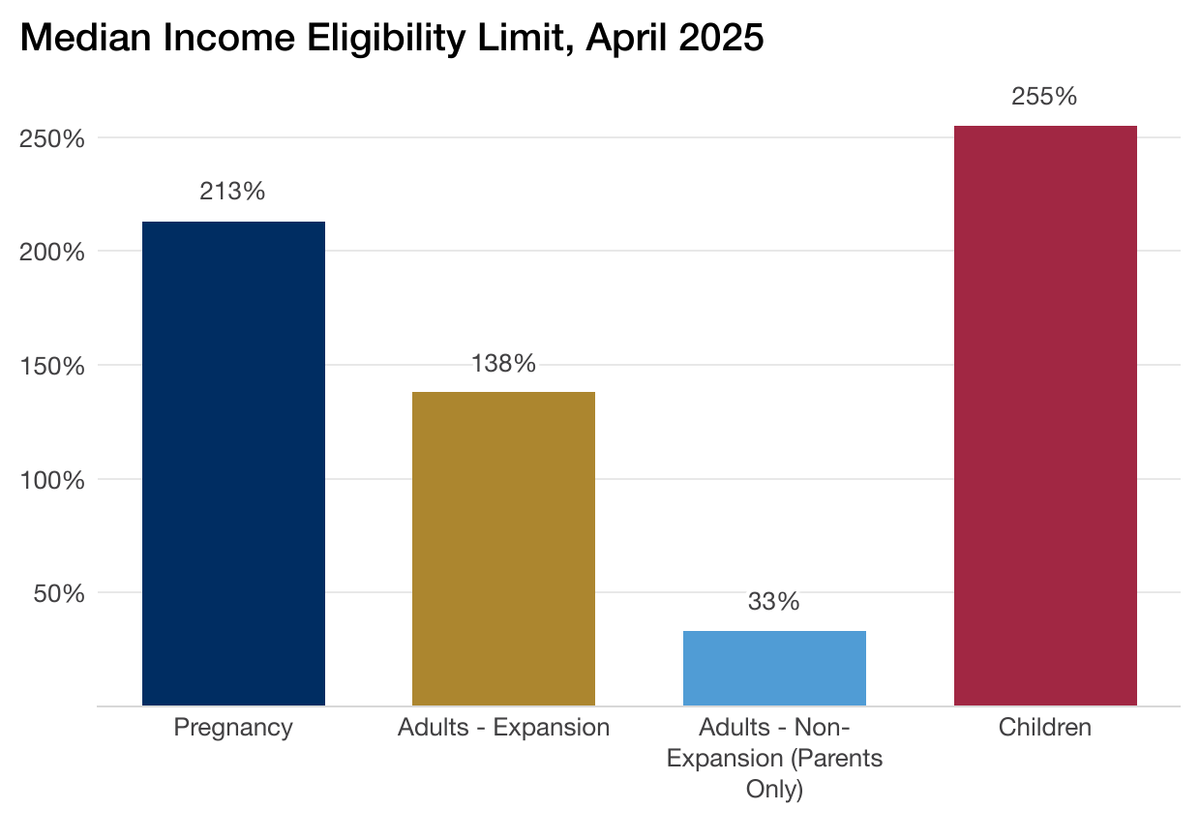
Medicaid and CHIP provide health coverage for about 80 million low-income children, adults, and seniors
Source: Brooks, T. et al., "Medicaid and CHIP Eligibility, Enrollment, and Renewal Policies as States Resume Routine Operations Following the Unwinding of the Pandemic-Era Continuous Enrollment Provision" (KFF and Georgetown University Center for Children and Families: April 2025).
Notes:
In addition to children, we also know many adults from early teens to seniors use Medicaid for some or all health care coverage. Most adults and children are enrolled in the income-based categories of Medicaid, others based on their disability status. For the income-based categories, shown here, states have some leeway with how high to set income eligibility levels beyond federal minimums. Children and pregnant women by far have the highest income eligibility across states – you see those medians here.
THE ACA created a new category of adult Medicaid eligibility for all adults up to 138% of poverty, which the SC made optional for states. This is represented in the gold bar you see- 30 states and DC have adopted. Before this option, low-income adults without dependent children had no option for affordable coverage. Parents could be covered at very low levels – You can see this in the 10 states that have not yet adopted the ACA expansion (blue bar). For adults in non-expansion states, only very low-income parents with dependent children qualify for coverage.

Slide 7
The ACA’s Medicaid Expansion
Extends coverage to all adults under 138% of the federal poverty line (FPL), or $26,650 for a family of three.
Those covered include:
low-wage workers
people experiencing physical or mental health conditions, disabilities
caregivers
women of child-bearing age
Notes:
Medicaid expansion has helped to reduce the uninsured rate and improve health care access, affordability, and financial security among the low-income adult population. More recent research shows improvements in health outcomes and continues to show positive effects for providers (particularly rural hospitals) and for sexual and reproductive health.

Slide 8
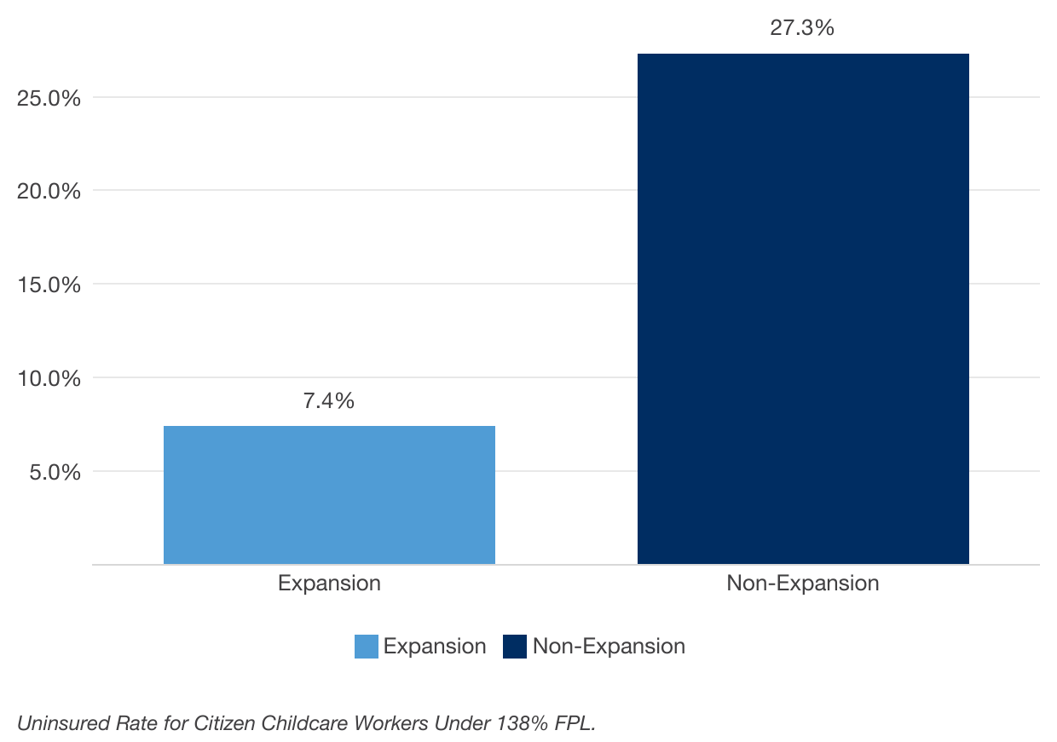
Uninsured Rate for Child Care Workers by State Medicaid Expansion Status, 2023
Medicaid, particularly Medicaid expansion, plays a critical role in supporting the child care workforce
Child care workers in non-expansion states are nearly four times more likely to be uninsured than their counterparts in expansion states.
Source: Georgetown University Center for Children and Families analysis of U.S. Census Bureau 2023 American Community Survey (ACS) Public Use Microdata Sample (PUMS).
Notes:
The medicaid expansion, along with ACA marketplace, has had a similar effect for adults that we’ve seen Medicaid do for kids since its inception – driving the uninsured rates to all-time lows.
This story is a really important one for the child care workforce. Our paper details Medicaid coverage for child care workers, as declined in U.S. job classification categories.
In 2023, non-expansion states had an uninsurance rate for children care workers that was nearly 4X that of those in expansion states, under 5 %. We looked at this same split a few years ago with 2019 data, which was about 3X– the gap continues to grow
2019 = 16% and

Slide 9
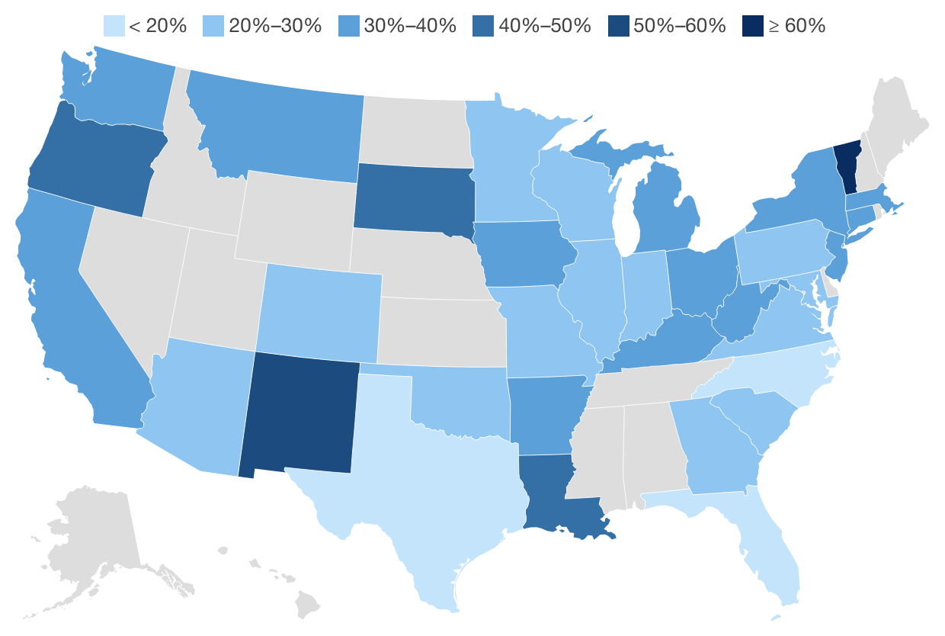
Percentage Child Care Workers Covered by Medicaid, 2023
Data include citizen, non-elderly adult (19-64) workers who identified as childcare workers according to ACS occupation codes. States without data suppressed due to poor reliability.
Source: Georgetown University Center for Children and Families analysis of U.S. Census Bureau 2023 American Community Survey (ACS) Public Use Microdata Sample (PUMS).
Notes:
WE also looked at Medicaid coverage for child care workers by state, and the theme of expansion shows up again– largely expansion states in the high %s
Range from TX (12.7%) to more than half in VT New Mexico
note about NC (17%) and SD (44%) – may be even more of an undercount
NC likely does not reflect expansion – began in December 2023. SD at 44% but could be much higher with a full year (started at 7/1/23)

Slide 10
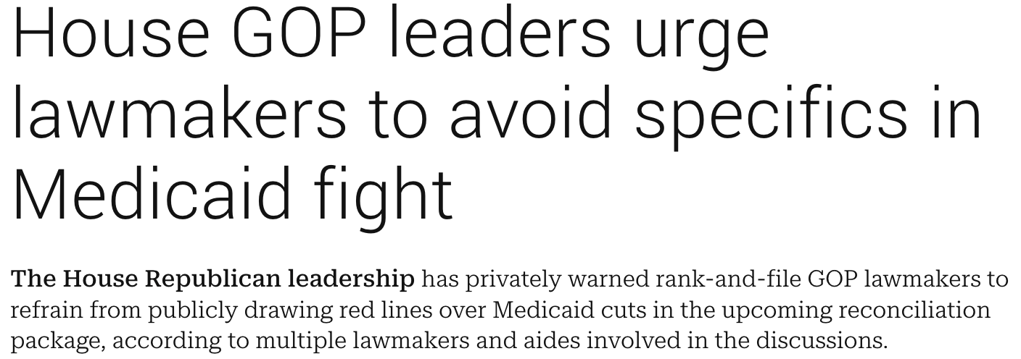
STATUS OF PROPOSALS TO CHANGE MEDICAID POLICY
AS OF APRIL 29, 2025
Sources: B. Leonard and A. Cancryn, Trump may 'love and cherish' Medicaid. He and Congress aren't ruling out cutting it, POLITICO Pro, February 6, 2025.
J. Appleby, Bill That Congressman Says Protects Medicaid Doesn’t– And Would Likely Require Cutting It, KFF Health News, March 25, 2025.
J. Brown, House GOP Passes Senate-Amended Budget, Setting Stage For Medicaid Cuts In Reconciliation, Inside Health Policy, April 11, 2025.
Sherman, J. et al. House GOP leaders urge lawmakers to avoid specifics in Medicaid fight, Punchbowl News, April 21, 2025.
Notes:
Number - reconciliation process - seeking at least on House side to cut $880B from Medicaid, possibly less.
Hard to overstate the magnitude of

Slide 11
Proposals for Medicaid Policy Change
Limits on federal funds
Other Cuts
Eliminate 90% FMAP matching rate or federal funding cap for ACA Medicaid expansion (adults).
Impose mandatory work requirements on adults.
Restrict state use of provider taxes.
Increase red tape barriers to enrollment, more frequent eligibility checks
Restrict coverage of immigrants.
Some proposals would impose a per capita cap on federal Medicaid funding or use Medicaid block grant.
Restructures Medicaid financing: States would receive a fixed amount of federal Medicaid funds regardless of actual costs.
Notes:
Regardless of the proposed means– these are cuts that would dramatically reduce health coverage, increase costs to families
PCC on expansion - https://www.kff.org/affordable-care-act/issue-brief/a-medicaid-per-capita-cap-on-the-aca-expansion-population-state-by-state-estimates/
https://www.kff.org/medicaid/issue-brief/a-medicaid-per-capita-cap-on-the-aca-expansion-population-state-by-state-estimates/
https://80m.beehiiv.com/p/medicaid-madness-what-states-and-providers-need-to-know-about-budget-reconciliation-4d1f

Slide 12
Impact of Financing Changes
Huge cost shift to states due to loss of federal dollars.
Loss of health insurance for possibly millions of people.
State decisions about how to make up funding gaps.

Slide 13
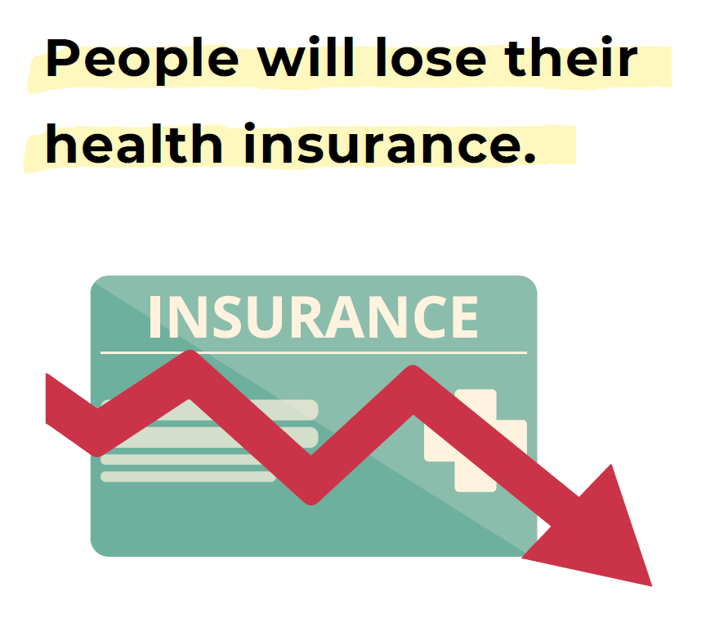
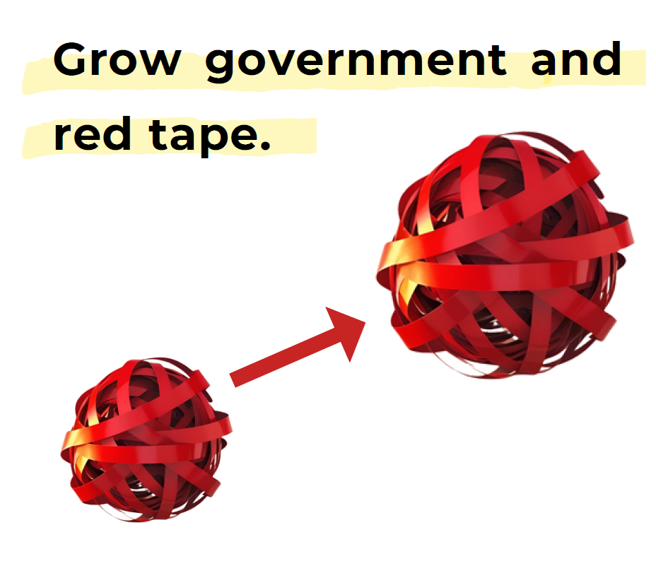
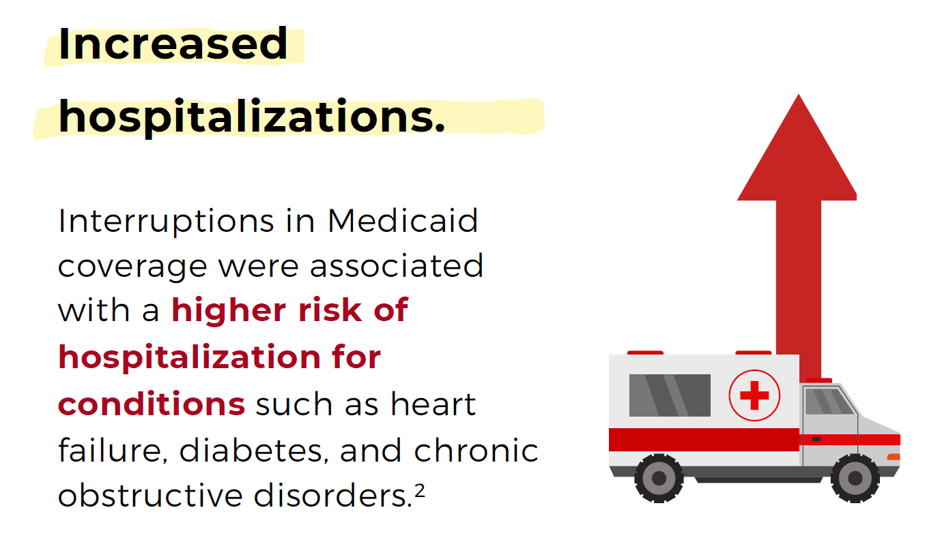
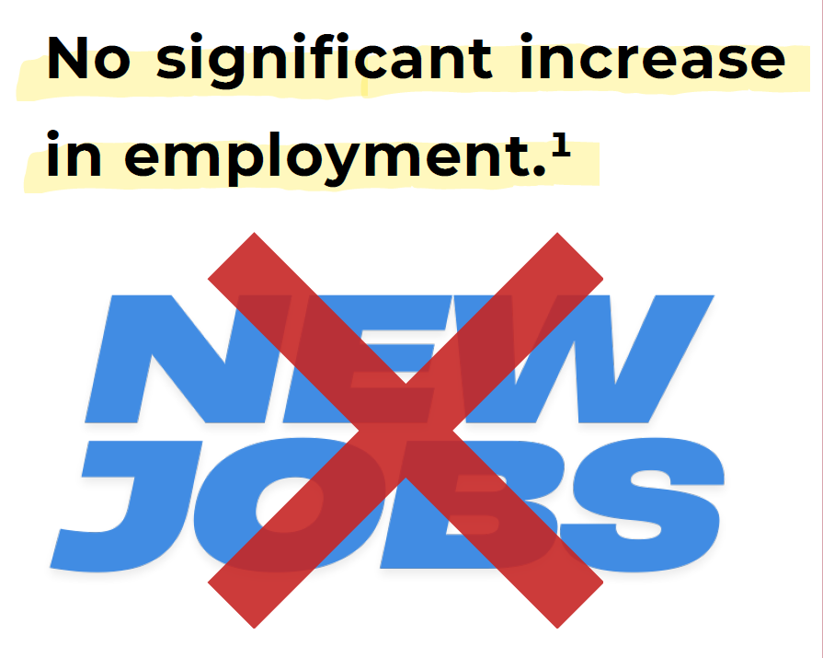
Impact of Eligibility Changes, Work Requirements
[1]Benjamin D. Sommers, M.D., Ph.D., Anna L. Goldman, M.D., M.P.A., M.P.H., Robert J. Blendon, Sc.D., et. al., “Medicaid Work Requirements — Results from the First Year in Arkansas,” New England Journal of Medicine, 381:1073-1082, June 19, 2019. [2] Andrew Bindman, Amitabha Chattopadhyay, and G. M. Auerback. “Interruptions in Medicaid coverage and risk for hospitalization for ambulatory care-sensitive conditions,” Annals of Internal Medicine, 2008. [3]Ohio Association of Foodbanks, Comprehensive Report: Able-Bodied Adults Without Dependents, 2015, [4] MaryBeth Musumeci “Disability and Technical Issues Were Key Barriers to Meeting Arkansas’ Medicaid Work and Reporting Requirements in 2018” Kaiser Family Foundation, June 2019.
Notes:
Experiences in AR, GA

Slide 14
Reactions and Reflections

Slide 15
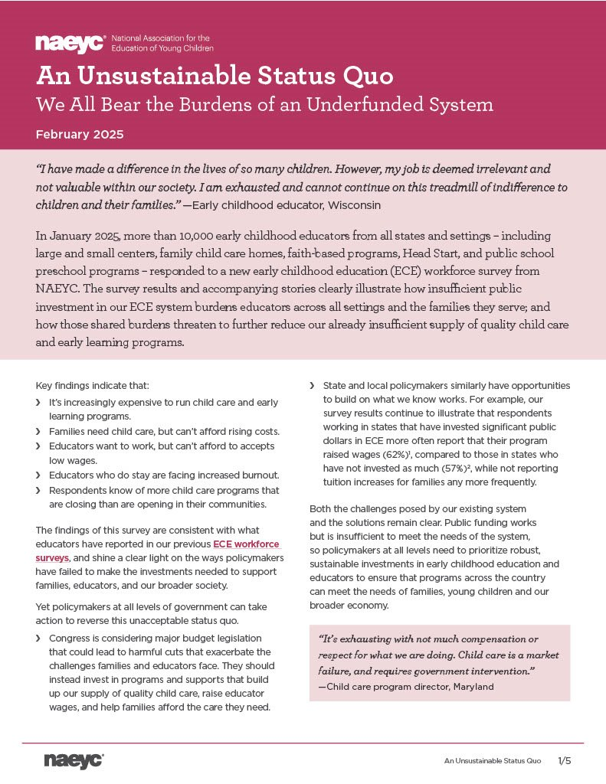
ECE Workforce Survey 2025
Administered in January 2025
Responses from 10,000+ early childhood educators
Representing every state and program setting, large and small
State by state data briefs
Notes:
non-randomized/convenience sample of 10,066 individuals working in early childhood education settings who completed the survey in English or Spanish between January 6-27, 2025. To generate a more representative national sample from the pool of responses, a probability proportional to size (PPS) methodology was used to pull samples by state that are benchmarked to the share of the total early childhood workforce by state. The authors relied upon the methodology employed by the CSCCE’s Early Childhood Workforce Index estimates of the size of each state’s ECE workforce using U.S. Census Bureau ACS data (https://cscce.berkeley.edu/wp-content/uploads/2024/11/Appendix-Table-2.1_2024-Index.pdf). The final sample size for analysis is 9,883. The respondents represent providers in 50 states as well as Washington, DC and Puerto Rico; 11% report that they work in family child care homes while 54% report that they work in center-based child care. Others work in public school preK and Head Start. The survey links were shared widely through email newsletters, listservs, social media, and via partnerships, and 10 randomly selected respondents were provided with a $100 gift card for participation in a sweepstakes.

Slide 16
Survey Findings
Rising Costs for Programs = Rising Costs for Families
Increases in operational costs could lead to tuition increases
Programs under-enrolled relative to their preferred capacity
Parents can’t afford to enroll their children
Compensation is too low to recruit and retain qualified staff
“Affordability is an issue for families, but we needed to increase tuition, due to increase in staffing wages.”
– Child care program director, Nebraska
Notes:
Rising Costs for Programs = Rising Costs for Families
- 32% pay more for rent
45% pay more for property insurance
46% pay more for liability insurance – we’ve been monitoring the issue of liability insurance since our survey last year which found that programs are experiencing an overall lack of access to LI due to rising costs and being dropped or denied coverage.
We know that if programs have higher costs they must find a way to make those costs which means many programs will be forced to raise tuition for families.
55% indicated under-enrollment relative to their preferred capacity
Parents can’t afford to enroll their children (41%)
Compensation is too low to recruit and retain enough qualified staff (37%)
We don’t have enough staff (36%)
In our advocacy work, it’s important to uplift how both of these things are happening on the family side (when it comes to affordability) and on the educator side when it comes to compensation.
In addition to these very real reasons for burnout, I’d like to bring up the impact that not having access to benefits (like healthcare, paid time off, sick leave) can have on health and wellbeing and how that’s another issue facing our field.

Slide 17
Survey Findings
Programs are raising wages, but burnout is still increasing
60% reported raising wages for staff in the last year (only 27% of FCC)
47% reported that their sense of burnout worsened
34% reported worse economic security compared to 16% who said it had improved
Reasons for Burnout
Low wages, physical and mental demands, insufficient resources to address children’s needs
Providers are considering leaving the field, but higher wages/benefits can help
Those who had access to benefits, including health insurance, were more likely to report wanting to stay in the field than those who did not
Those who were considering leaving cited higher wages and more support addressing children’s behavioral challenges as the supports that would most help them remain.
Notes:
While wages are increasing, levels of burnout are also high
- 60% reported raising wages and/or salaries for staff in the last year, but this was only true for 27% of FCC. We believe this is because often FCC owners can’t afford to take a salary.
- 47% reported that their sense of burnout worsened
Reasons for burnout:
- low wages
- physical and mental demands of the job
- insufficient resources to deal with children's developmental and behavioral challenges.
For FCC, too much paperwork and/or other reporting requirements also cited
In addition to these very real reasons for burnout, I’d like to bring up the impact that not having access to benefits (like healthcare, paid time off, sick leave) can have on health and wellbeing and how that’s another issue facing our field.

Slide 18
What You Can Do
Educate policymakers and key decision makers about the value of Medicaid and its role in the health and development of infants, toddlers, and their families.
Highlight the harmful impacts Medicaid cuts would have on families, early care and education providers, the health system, state budgets and state economies.
Leverage power of coalitions and partnerships to raise awareness of the importance of Medicaid for children, early intervention, supports for other children with disabilities, child care workforce, and more.
Partner with groups representing the spectrum of Medicaid beneficiaries (e.g. advocates for seniors, adults with disabilities).

Slide 19
For More Information
CLASP - https://www.clasp.org/
Infographic on Work Requirements
Medicaid Cuts Come Into Focus: Millions Stand to Lose Health Care
Federal Cuts to Child Care and Head Start
The Century Foundation - Beyond Health: Threats to Medicaid Would Endanger Child Care Too
Beyond Health: Medicaid Cuts Would Bring Widespread Harms to Americans
NAEYC - https://www.naeyc.org/
Georgetown CCF - https://ccf.georgetown.edu/
Fact Sheets on Medicaid and specific populations or child-serving sectors (Early Intervention, Maternal and Infant Health, Child Welfare)
Medicaid's Role in Small Towns and Rural Areas
Medicaid/CHIP Coverage by Congressional District & by School Districts, 2019-2023
50-state snapshots
X/Bluesky: @georgetownccf, @ewburak

