Slide 1
Share of Women of Childbearing Age with Medicaid Coverage by County Type, 2023
Note: “Small Towns/Rural Areas” include non-metropolitan counties with no urban areas of at least 50,000 residents. The District of Columbia, New Jersey, and Rhode Island have no counties classified as Small Towns/Rural Areas.
Source: County-level Medicaid/CHIP coverage estimates are based on an analysis of 2022-2023 American Community Survey (ACS) Public Use Microdata Sample (PUMS).

Slide 2
Share of Women of Childbearing Age with Medicaid Coverage in Small Towns/Rural Areas by State, 2023
Note: “Small Towns/Rural Areas” include non-metropolitan counties with no urban areas of at least 50,000 residents. The District of Columbia, New Jersey, and Rhode Island have no counties classified as Small Towns/Rural Areas.
Source: County-level Medicaid/CHIP coverage estimates are based on an analysis of 2022-2023 American Community Survey (ACS) Public Use Microdata Sample (PUMS).

Slide 3
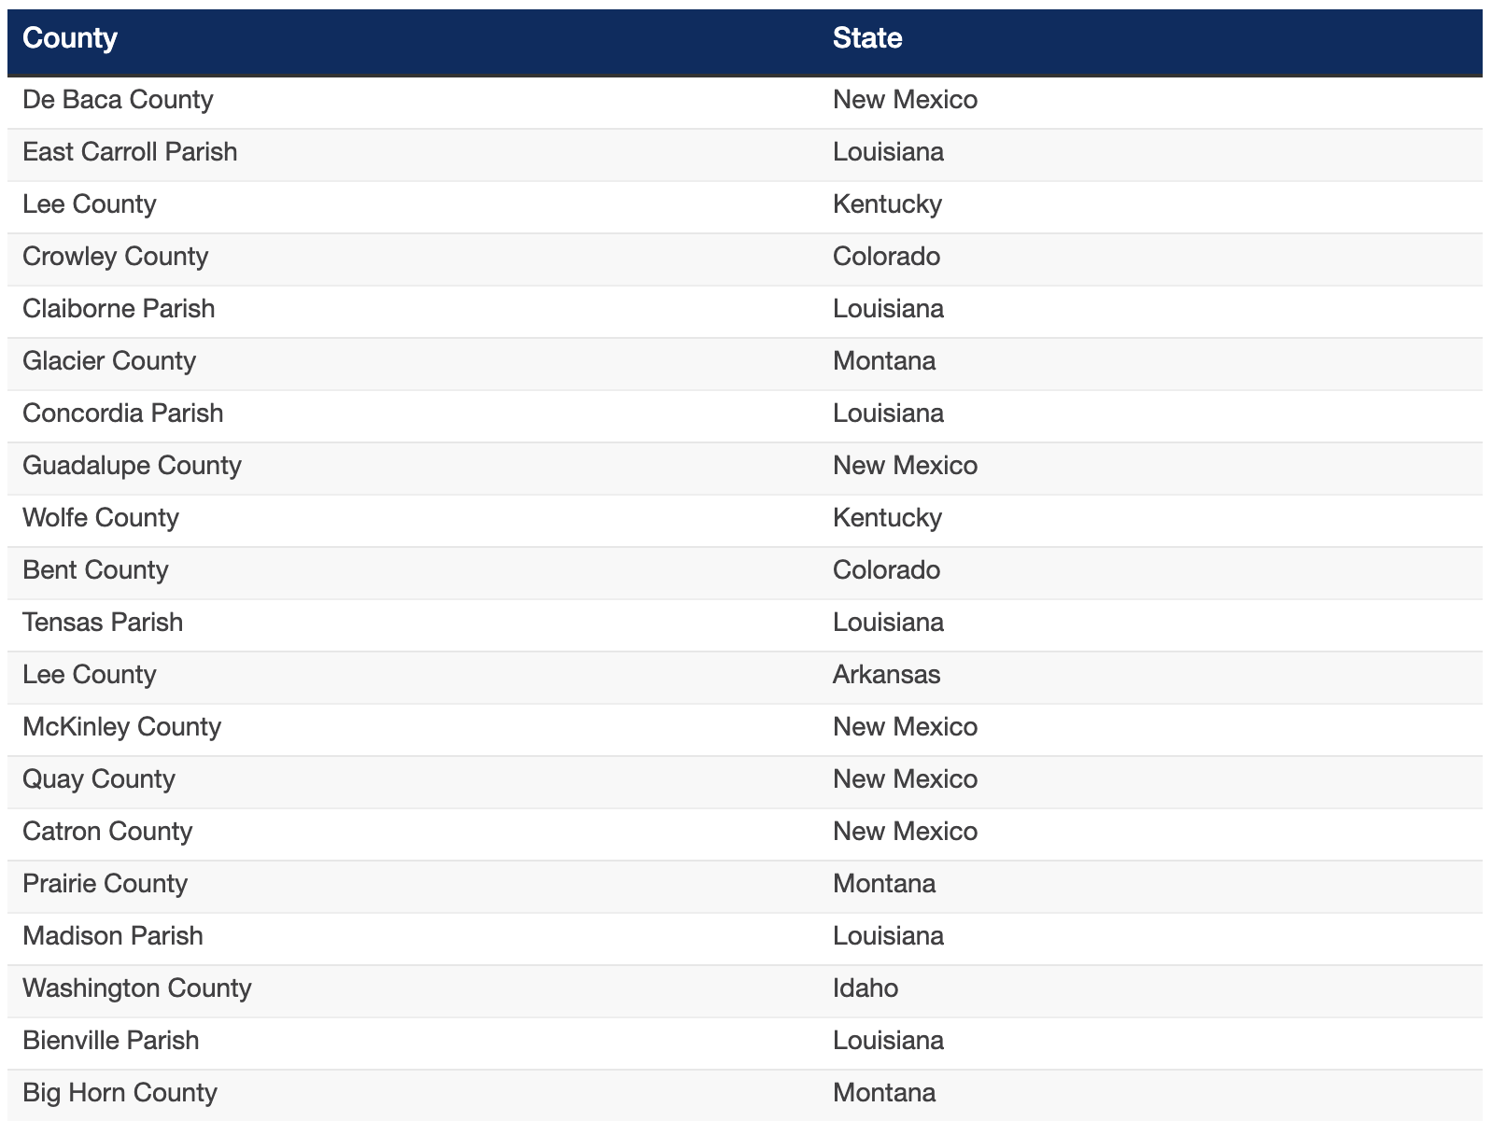
Small Town/Rural Area Counties with Approximately Half of Women of Childbearing Age Covered by Medicaid, 2023
Note: “Small Towns/Rural Areas” include non-metropolitan counties with no urban areas of at least 50,000 residents. The District of Columbia, New Jersey, and Rhode Island have no counties classified as Small Towns/Rural Areas. Approximately half of women of childbearing age are covered by Medicaid in above counties; percentages are estimated based on county population characteristics, see text for more details.
Source: County-level Medicaid/CHIP coverage estimates are based on an analysis of 2022-2023 American Community Survey (ACS) Public Use Microdata Sample (PUMS).

Slide 4
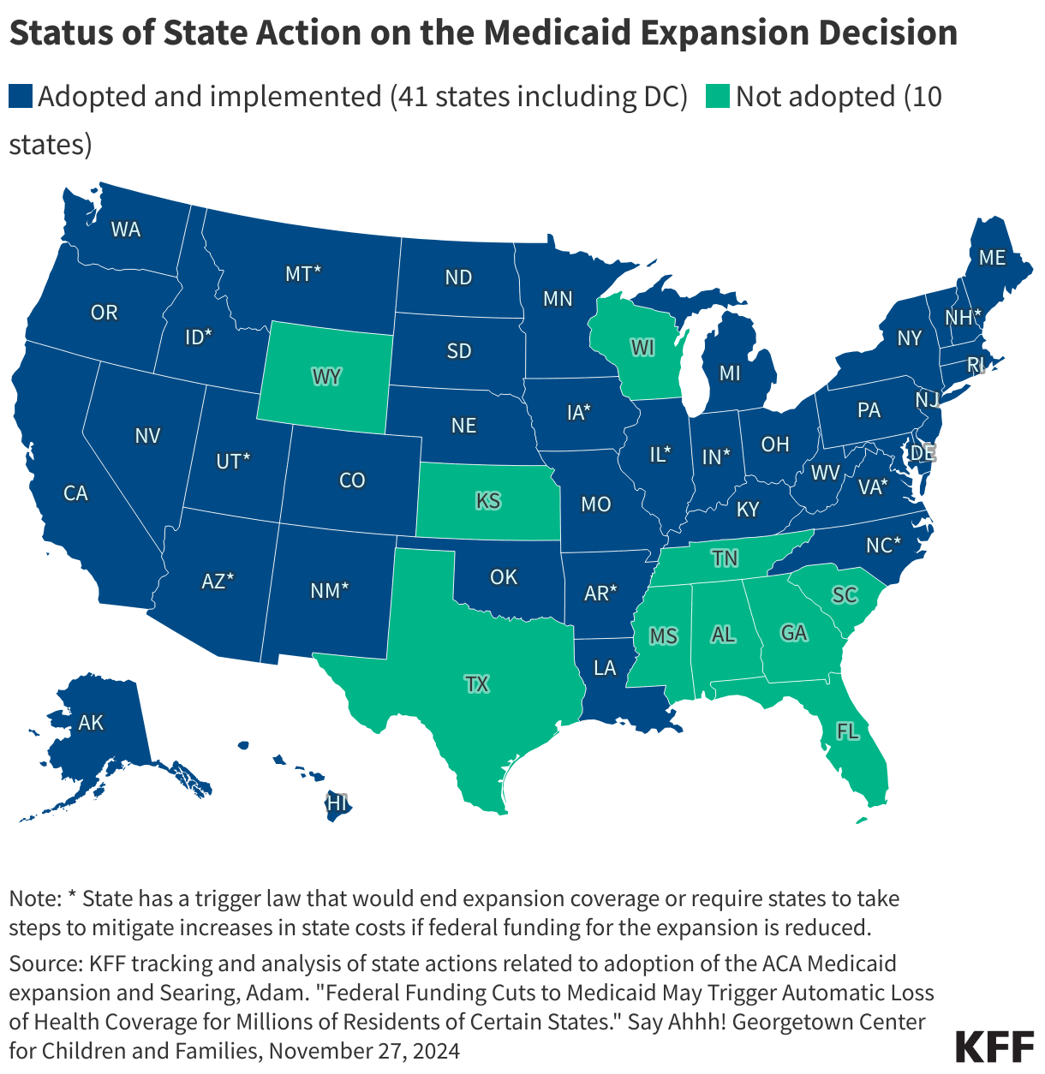
Status of State Action on the Medicaid Expansion Decision

Slide 5
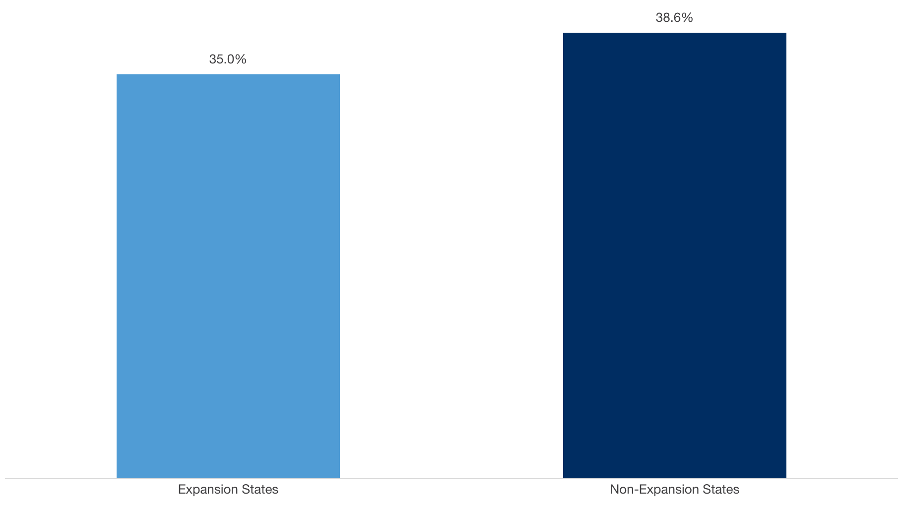
Women of Childbearing Age with Medicaid as a Share of Non-Elderly Adults with Medicaid, 2023
Note: “Small Towns/Rural Areas” include non-metropolitan counties with no urban areas of at least 50,000 residents. The District of Columbia, New Jersey, and Rhode Island have no counties classified as Small Towns/Rural Areas.
Source: County-level Medicaid/CHIP coverage estimates are based on an analysis of 2022-2023 American Community Survey (ACS) Public Use Microdata Sample (PUMS).

