Slide 1
How Many Children are Uninsured in the U.S.?
Joan Alker, Research Professor/Executive Director
Georgetown University Center for Children and Families
September 12, 2025

Slide 2
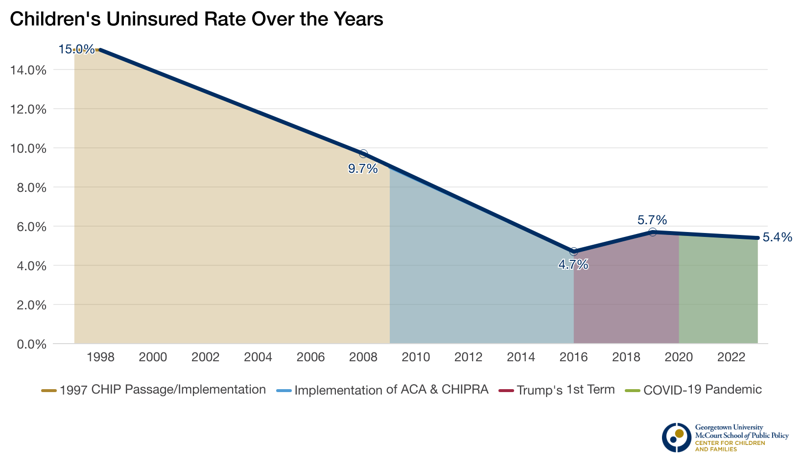
Children’s Uninsured Rate Over the Years

Slide 3
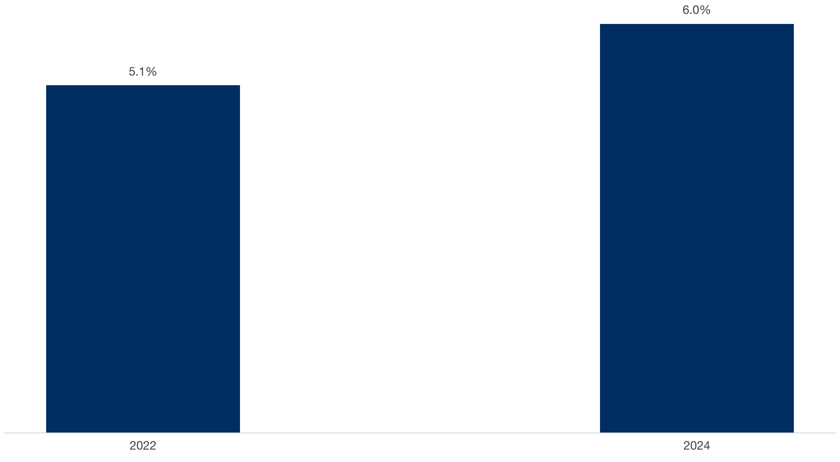
Change in Rate of Uninsured Children, 2022-2024
Change is significant at the 90% confidence level relative to prior year indicated.
Source: Georgetown University Center for Children and Families analysis of the U.S. Census Bureau American Community Survey (ACS) Table HIC-5, Health Insurance Coverage Status and Type of Coverage by State--Children Under 19: 2008 to 2024, Health Insurance Historical Tables.
Notes:
Percentage change in number of uninsured children under 19, 2024/2022:
Expansion states 20.2%
Non-expansion states 16.3%

Slide 4
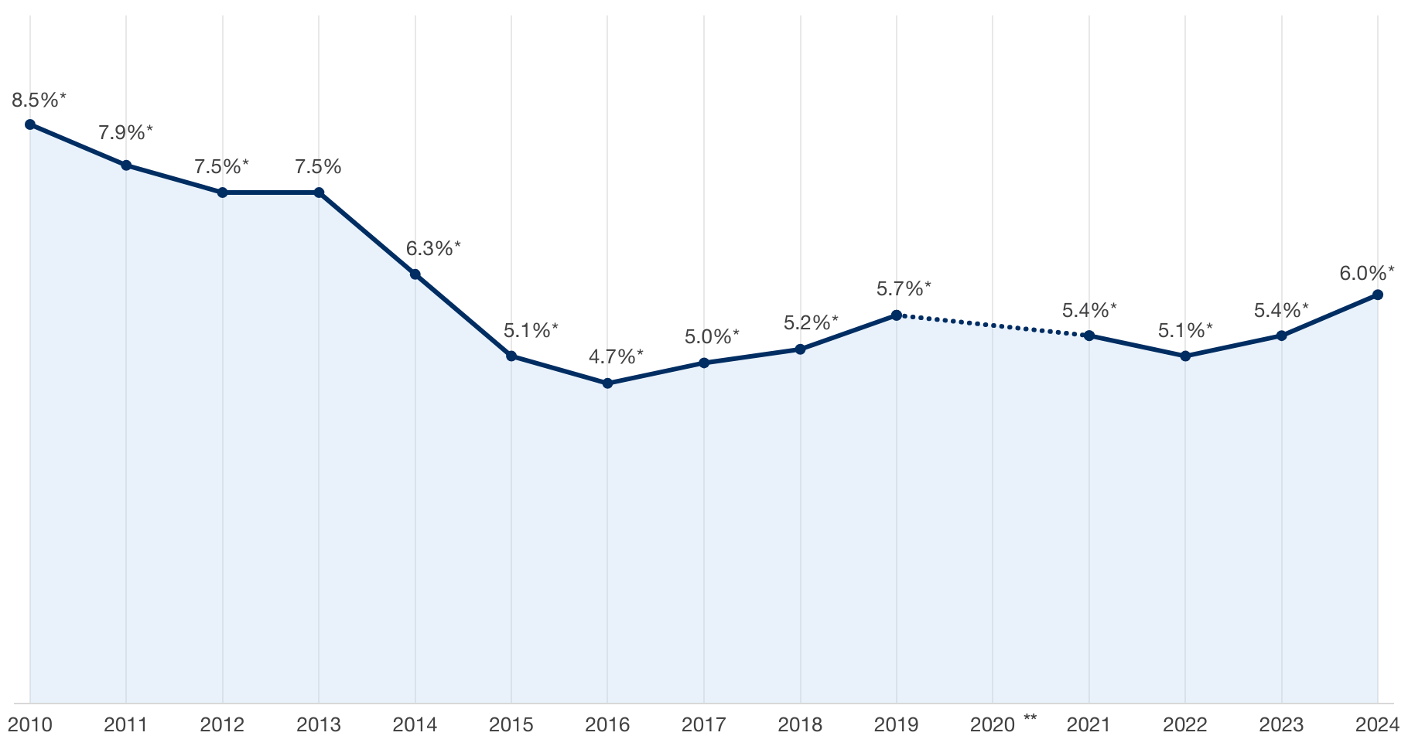
Rate of Uninsured Children in the United States, 2010-2024
* Change is significant at the 90% confidence level relative to the prior year indicated.
** Due to pandemic-related data quality issues, the U.S. Census Bureau did not release standard 1-year ACS estimates in 2020.
Source: Georgetown University Center for Children and Families analysis of the U.S. Census Bureau American Community Survey (ACS) Table HIC-5, Health Insurance Coverage Status and Type of Coverage by State--Children Under 19: 2008 to 2024, Health Insurance Historical Tables.

Slide 5
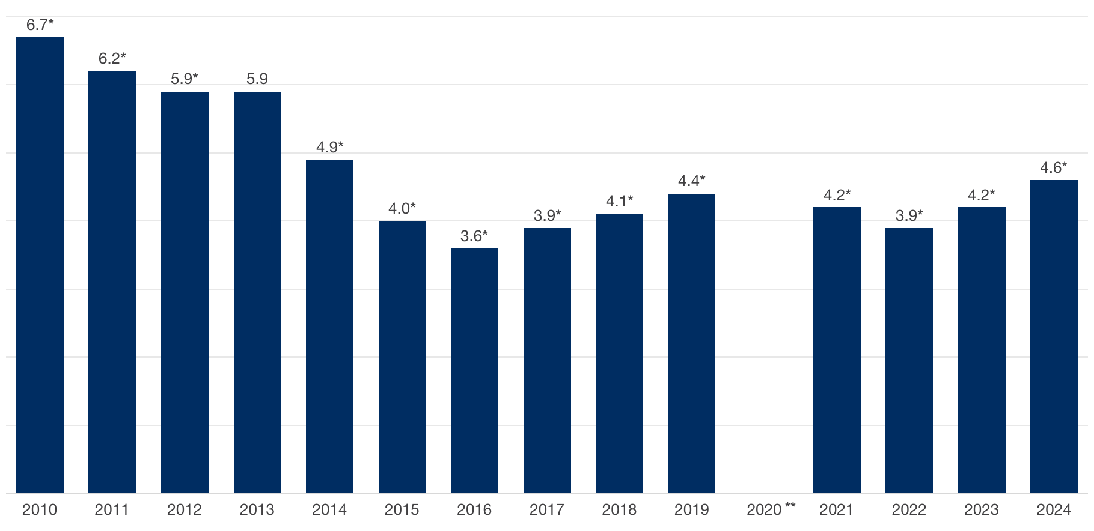
Number of Uninsured Children in the United States (in millions), 2010-2024
* Change is significant at the 90% confidence level relative to the prior year indicated.
** Due to pandemic-related data quality issues, the U.S. Census Bureau did not release standard 1-year ACS estimates in 2020.
Source: Georgetown University Center for Children and Families analysis of the U.S. Census Bureau American Community Survey (ACS) Table HIC-5, Health Insurance Coverage Status and Type of Coverage by State--Children Under 19: 2008 to 2024, Health Insurance Historical Tables.

Slide 6
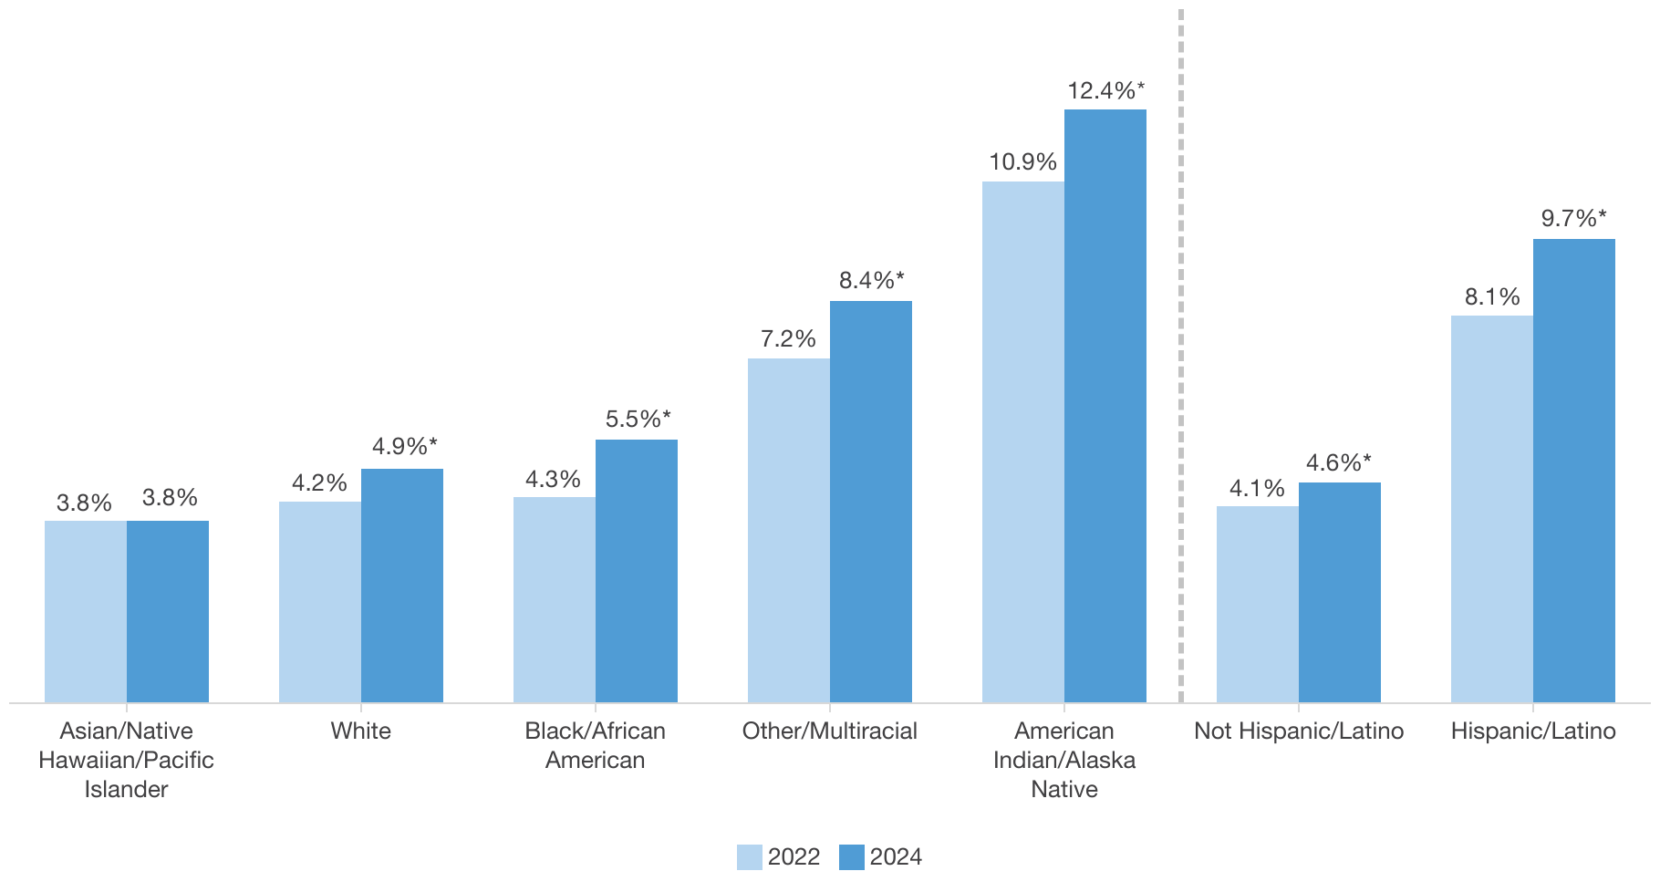
Rate of Uninsured Children in the United States by Race/Ethnicity, 2022-2024
* Change is significant at the 90% confidence level relative to the prior year indicated. Note: Hispanic/Latino refers to a person’s ethnicity, therefore Hispanic individuals may be of any race. The U.S. Census Bureau made changes to the ACS race and ethnicity questions beginning in 2020, which may affect the changes observed.
Source: Georgetown University Center for Children and Families analysis of the U.S. Census Bureau American Community Survey (ACS) Table HIC-5, Health Insurance Coverage Status and Type of Coverage by State--Children Under 19: 2008 to 2024, Health Insurance Historical Tables.

Slide 7
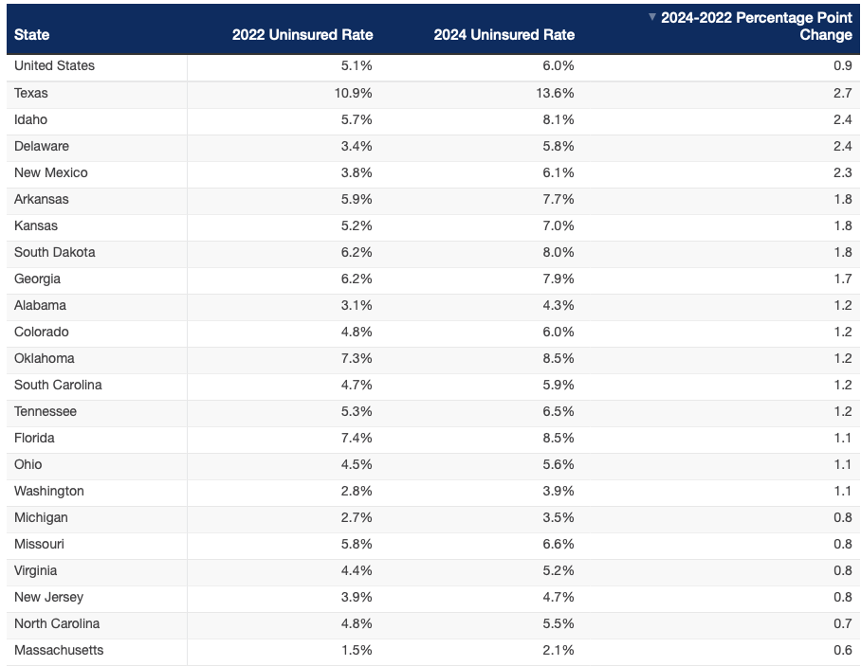
22 States Saw an Increase in Rate of Uninsured Children, 2022-2024
Changes are significant at the 90% confidence level relative to the prior year indicated.
Source: Georgetown University Center for Children and Families analysis of the U.S. Census Bureau American Community Survey (ACS) Table HIC-5, Health Insurance Coverage Status and Type of Coverage by State--Children Under 19: 2008 to 2024, Health Insurance Historical Tables.

Slide 8
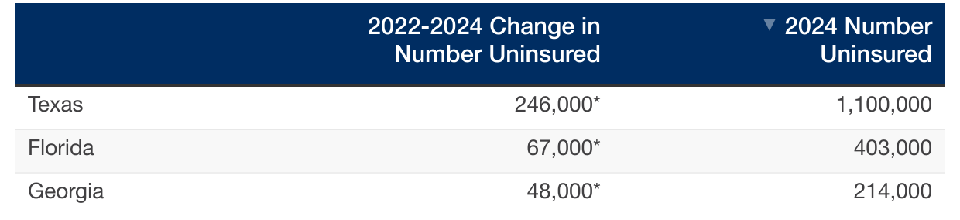
States with the Largest Growth in Number of Uninsured Children, 2022-2024
*Change is significant at the 90% confidence level relative to the prior year indicated
Source: Georgetown University Center for Children and Families analysis of the U.S. Census Bureau American Community Survey (ACS) Table HIC-5, Health Insurance Coverage Status and Type of Coverage by State--Children Under 19: 2008 to 2024, Health Insurance Historical Tables.

Slide 9
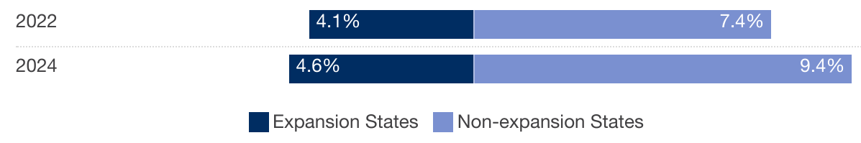
Rate of Uninsured Children by State Medicaid Expansion Status, 2022-2024
Changes are significant at the 90% confidence level relative to the prior year indicated.
Source: Georgetown University Center for Children and Families analysis of the U.S. Census Bureau American Community Survey (ACS) Table HIC-5, Health Insurance Coverage Status and Type of Coverage by State--Children Under 19: 2008 to 2024, Health Insurance Historical Tables.

Slide 10
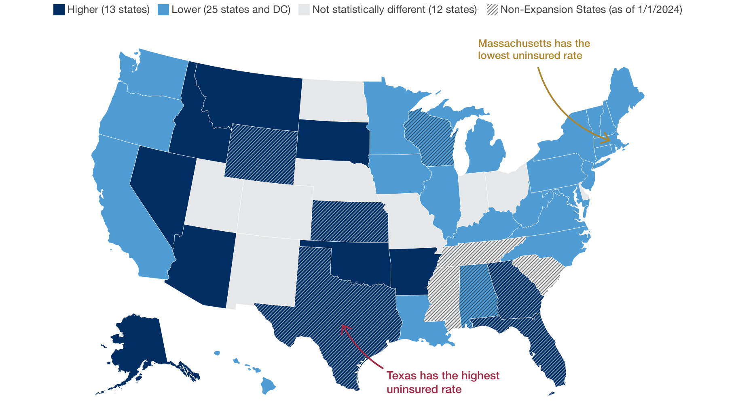
States with Higher and Lower Rates of Uninsured Children than the National Rate, 2024
Source: Georgetown University Center for Children and Families analysis of the U.S. Census Bureau American Community Survey (ACS) Table HIC-5, Health Insurance Coverage Status and Type of Coverage by State--Children Under 19: 2008 to 2024, Health Insurance Historical Tables.

Slide 11

More Resources Available from Georgetown CCF:
Medicaid Enrollment Tracker- https://ccf.georgetown.edu/unwinding-enrollment-data/
Resource on State-by-State Impacts- https://ccf.georgetown.edu/2025/08/15/new-resource-on-state-by-state-impacts-of-budget-reconciliation-law/
State Readiness Tracker- https://ccf.georgetown.edu/2025/09/04/are-states-ready-to-implement-hr-1-and-medicaid-work-reporting-requirements/
State Data Hub - https://kidshealthcarereport.ccf.georgetown.edu/
Say Ahhh! - A Health Policy Blog https://ccf.georgetown.edu/format/blog-posts/

